Slide 1
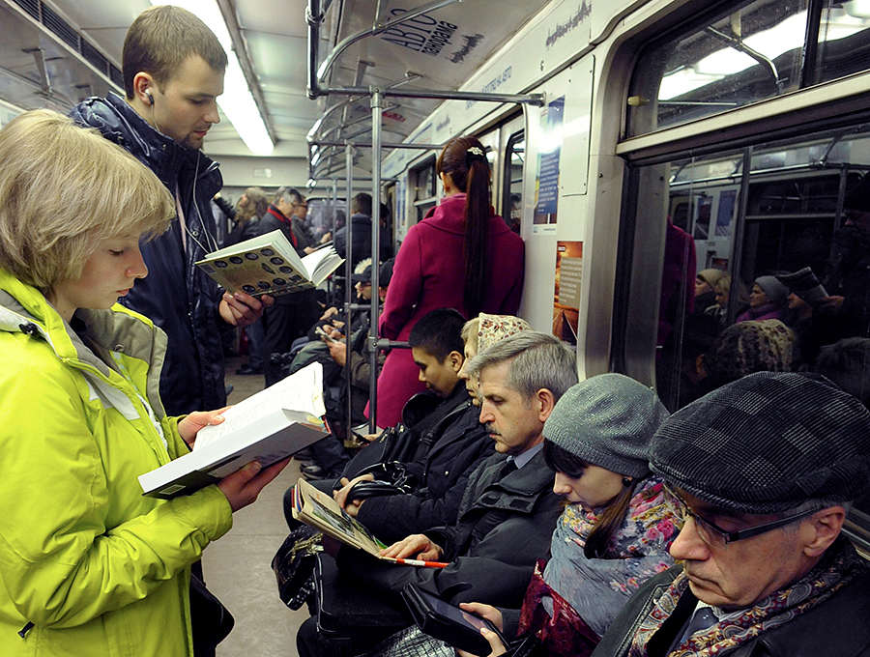
THE PLEASURE OF READING
March,the 2nd
7 «G»Form

Slide 2
Is reading important for you?
+ _
+ it is the perfect way to make fun to entertain oneself to feel comfortable to spend free time to relax not to be alone not to feel bored | - it is easier to watch TV or video to hurt eyes to make me think hard to be boring to give a headache to take too much time

Slide 3
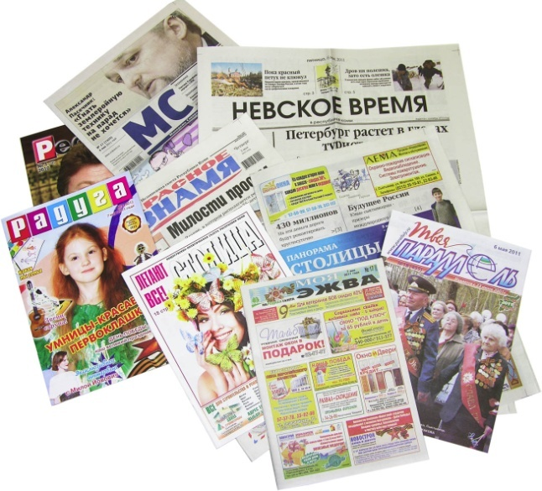
What do you read?

Slide 4
Do you agree or not?
3. Don’t judge a book by its cover
Proverb
4. Reading is to the mind what exercise is to the body.
Richard Steele, an Irish writer and politician
1. A room without books is a body without a soul.
Cicero, a Roman philosopher, politician
2. Choose an author as you choose a friend. Sir Christopher Wren, an English architect

Slide 5
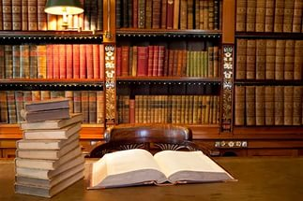
Books can be
interesting
gripping
entertaining
amusing
delightful
funny
humorous
witty
truthful

Slide 6
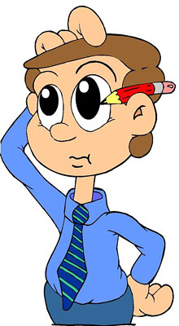
Do the crossword «Books can be……»
S | F | E | N | J | O | Y | A | B | L | E
P | I | X | E | T | U | N | M | R | O | M
O | A | C | R | E | X | E | U | C | R | E
W | I | I | T | Y | A | O | S | E | I | R
E | A | T | Y | B | O | R | I | N | G | H
R | M | I | R | T | A | E | N | Q | I | A
F | U | N | N | Y | A | O | G | A | N | Z
U | F | G | E | J | H | G | E | T | A | E
L | S | H | A | L | L | O | W | E | L | X
Y | D | E | P | R | E | S | S | I | N | G

Slide 7
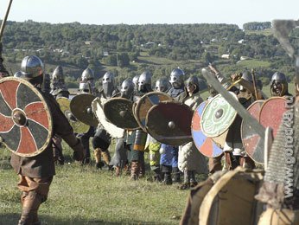
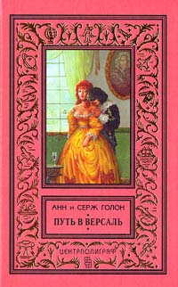
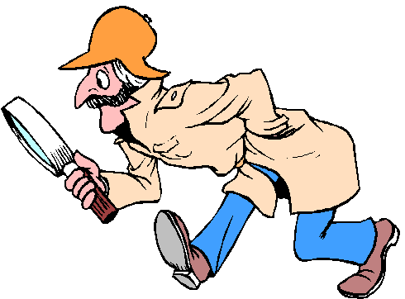
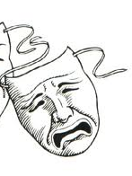
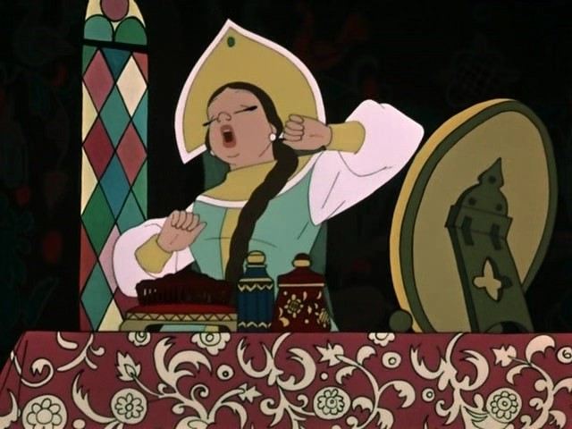
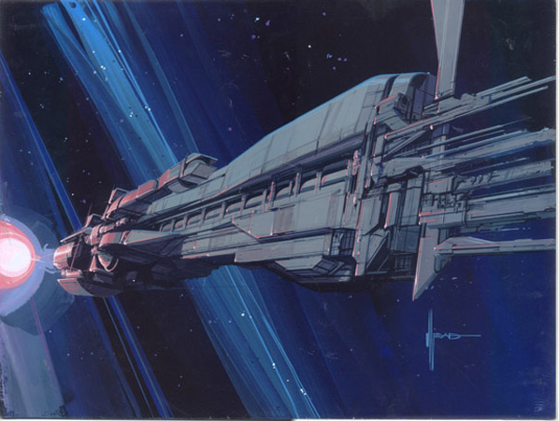
Adventure
Drama
Detective
Science fiction
Fairy tale
Humorous story
Comedy
Novel
History
Biography

Slide 8
Match the type of the book with its definition
Horror a) describes various “unreal” or supernatural things
2. Historical fiction b) describes life in the wild American west
3. Romances c) stories that mainly focus on love and relationship
4. Western d) a novel, written following a particular time period
5. Science fiction e) put the focus on stuffs such as future worlds, space travel
6. Fantasy f) this type is meant to scare its readers

Slide 9
Adventure
A story is an exciting story about a hero who goes on an unusual journey and does new and dangerous things.
A story is about events that take place in the future or in space and usually describes strange creatures and robots
A is a serious and emotional play written for the theatre, television or radio.
A is a story about a crime or a strange event that is difficult to explain.
A is a funny story with a happy ending.
A is the story of a person’s life written by another person.
Science fiction
Drama
Mystery
Humorous story
Biography
2) A. Mystery
B. Drama
C. Science
fiction
4)A. Mystery
B. Legend
C. Fairy
tale
5) A. Adventure
B. Myth
C. Humorous
story
6) A. Novel
B. Biography
C. History
A. Comedy
B. Adventure
C. Suspense
3) A. Drama
B. Comedy
C. Novel

Slide 10
Stories by A. Christie | is | A war novel
Five on treasure island by Mary Blyton |  | An adventure story
Vitya Maleev at school and at home by Nosov |  | A humorous story
War and peace by Tolstoy |  | A detective story
Romeo and Juliet by W. Shakespeare |  | A science fiction
Cinderella |  | A fairy tale
The life of A.Pushkin |  | A horror story
The Time Machine by G.Wells |  | A drama
Frankenstein by Marry Shelly |  | A biography

Slide 11
Give brief information about the writers

Slide 12
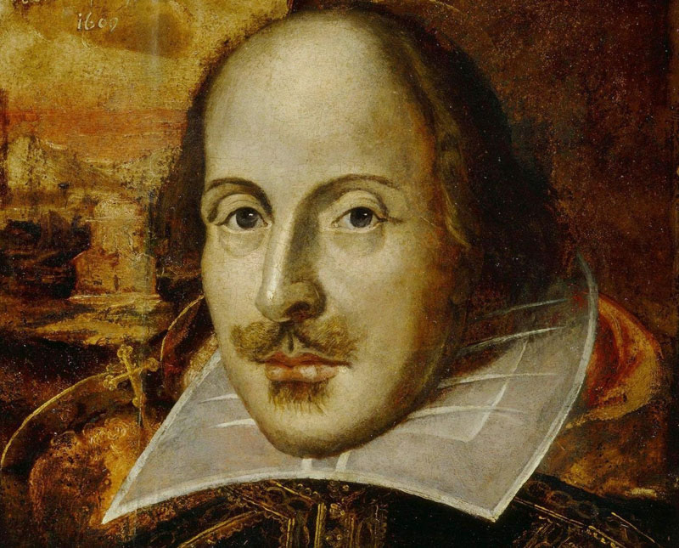
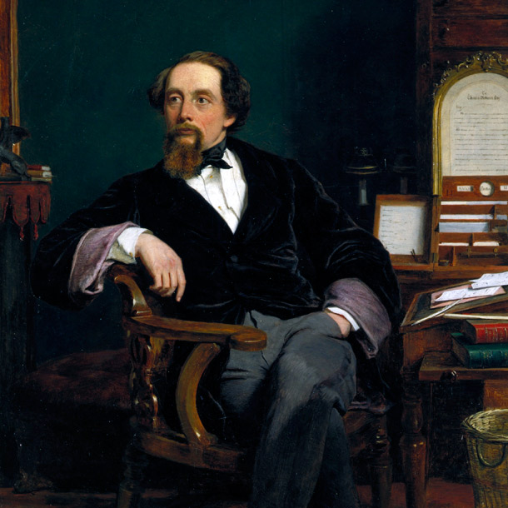
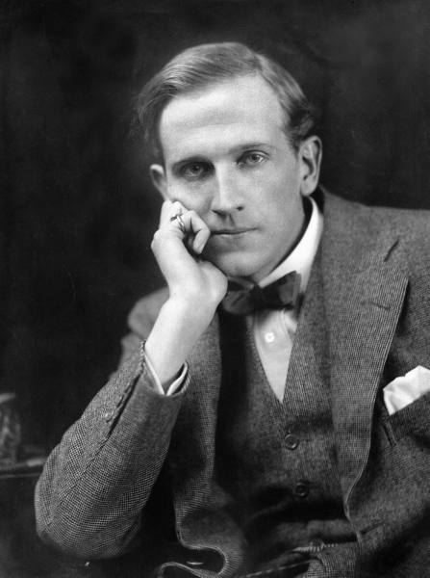
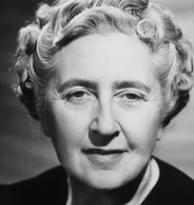
English writers
Where and when were they born?
What kind of books did they write?
William Shakespeare
Charles Dickens
Alan Alexander Milne
Agatha Christie

Slide 13
William Shakespeare

Slide 14
Charles Dickens

Slide 15
Alan Alexander Milne

Slide 16
Agatha Christie

Slide 17
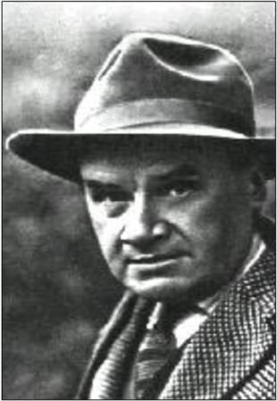
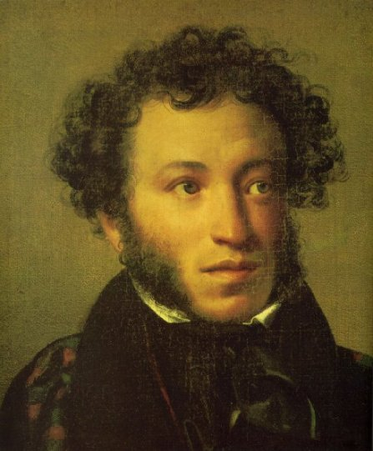
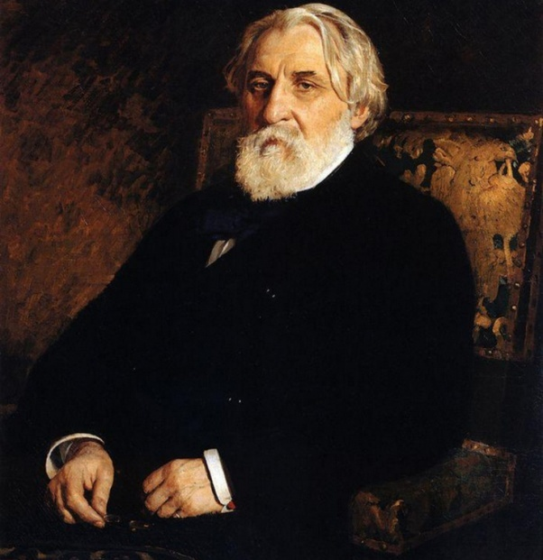
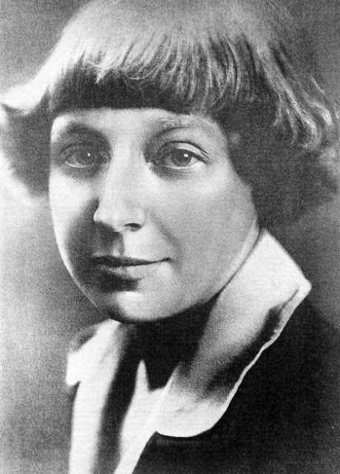
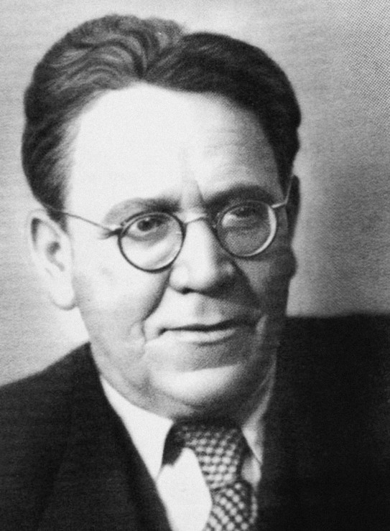
Russians writers
Nikolay Nosov
Alexander Pushkin
Ivan Turgenev
Where and when were they born?
What kind of books did they write?
Samuil Marshak
Marina Tsvetaeva

Slide 18
Marina Tsvetaeva

Slide 19
Samuil Marshak

Slide 20
Nikolay Nosov

Slide 21
Ivan Turgenev

Slide 22
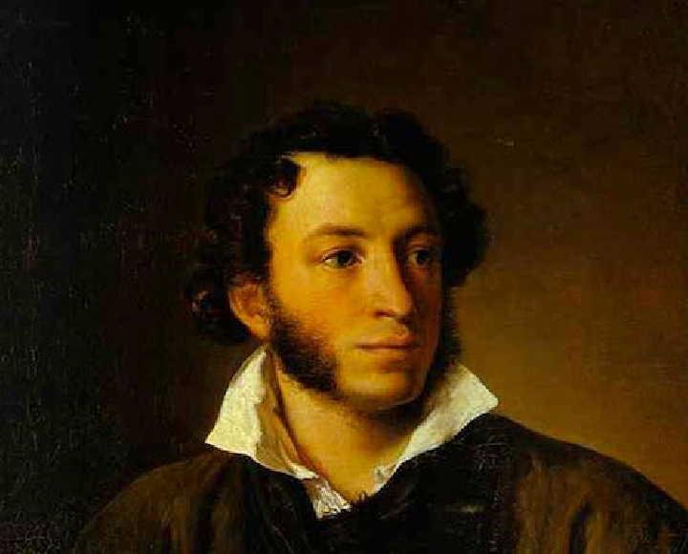
Alexander Pushkin

Slide 23
SPEAKING
Give a 2-minute talk on your favourite book.
Remember to say :
What kind of book it is
Who the main characters are and whether you like them
What happens in the book
Why it is your favourite

Slide 24
My favourite book
My favourite book is………………
It’s a (detective, humorous, short) story (novel,poem).
Its author is…………….
He is a talented (creative,extraordinary………).
The main character(s) of this book is (are)….
I like him (her) because he (she) is kind,……..
The story (poem, novel) tells about love,(friendship, nobility,……
I like it because it teaches life, kindness,……….

Slide 25
LISTENING «A book to read on holidays»
True or false
1. Alex is going to the school library.
2.He likes historical novels.
3. Alex has not read Alexander Dumas.
4. Alex does not like Walter Scott.
5.«Rob Roy» by Walter Scott is an adventure novel.
6.Jane is reading Charles Dickens now.

Slide 26
LISTENING «A book to read on holidays»
Answer the questions
1.What kind of books does Alex prefer?
2. Does Alex like Walter Scott ?
3. What novel did he read some years ago?
4. What novel by Walter Scott has Jane already read?
5.What is Jane reading now?

Slide 27
SPEAKING Give a 2-minute talk on the topic «What book would you recommend to read?»
I would recommend the book…
…was written by…
It is…
It is about…
The main characters in the book are…
I love reading it because…

Slide 28
Let’s sing a song
My books are just standing on bookshelves
That I’m always happy to read My favourite’s under my pillow. The English book is what I need. Chorus: Read books, read books, They were invented to read, to read. Read books, read books, English book is what I need. The book that was written in English Improves your knowledge as well, It teaches your lexics and grammar And how the English words spell.
Chorus.

Slide 29
impression
funny, humorous, witty
What?
At home, at school, in the parks
horror, fantasy, drama
books, newspapers, magazines
Where?
genres
School library, friends, relatives
READING
Where do you take books?
English writers
Milne, Christie, Dickens
Russian writers
characters
Nosov, Pushkin, Marshak
Georgina, Timothy, Winnie-the-Pooh , Cinderella

Slide 30
«Except a living man there is nothing more wonderful than a book»
Charles Kingsley,
English writer

Slide 31
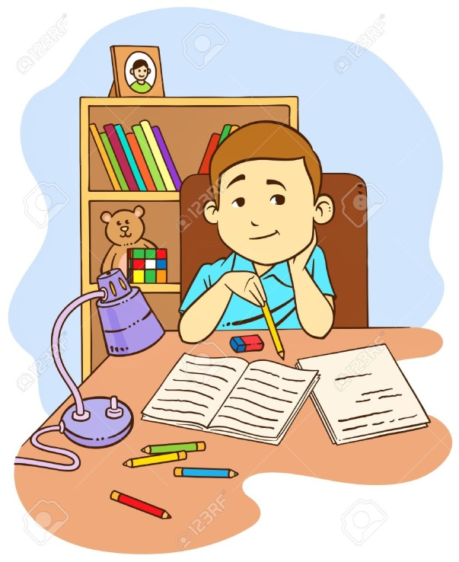
Home work- Write a letter to your friend about a book you have read recently.

