Slide 1
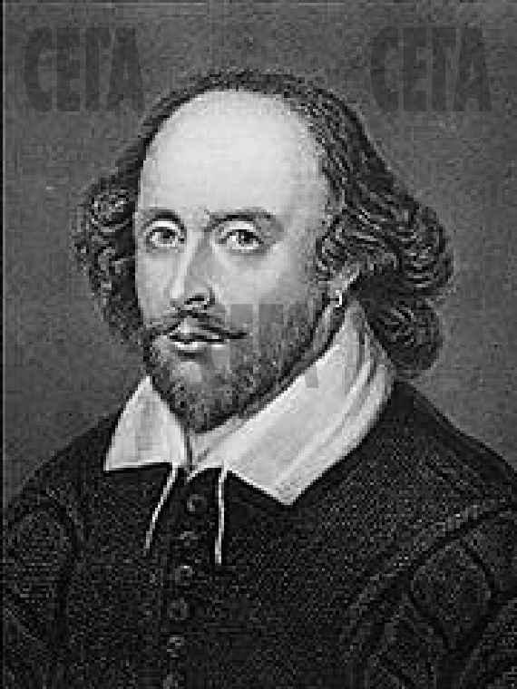
WILLIAM SHAKESPEARE 1564 - 1616

Slide 2
AII THE WORLD’S A STAGE, AND AII THE MEN AND WOMEN - MERELY PLAYERS.
W. SHAKESPEARE
(«AS YOU LIKE IT»)

Slide 3
April 23, 1564
In Stratford–upon–Avon.
His mother was the daughter
of a farmer.
His father was a glove-maker.

Slide 4
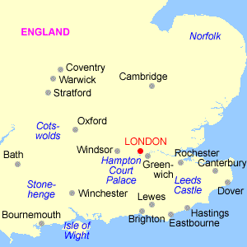
STRATFORD
HAS ANGLO-SAXON
ORIGINS
STANDS ON THE
RIVER AVON
OVER 800 YEARS
OLD

Slide 5
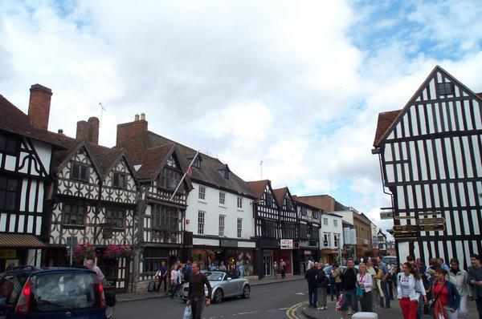
STRATFORD-UPON-AVON NOWADAYS

Slide 6
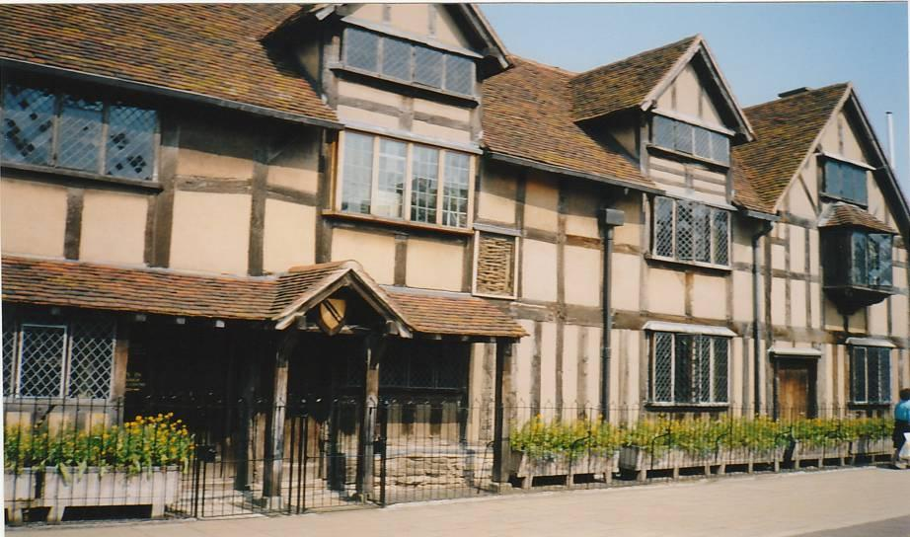
W.SHAKESPEARE’S BIRTHPLACE
HENLY STREET

Slide 7
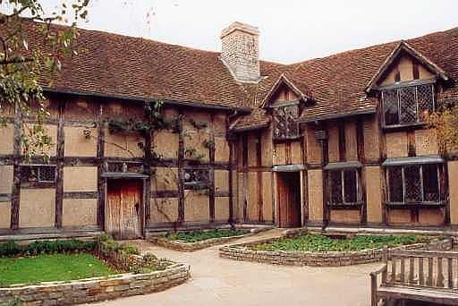
THE BACKYARD OF THE HOUSE

Slide 8
AT THE AGE OF 7 WILLIAM WAS SENT TO GRAMMAR SCHOOL, WHERE HE STUDIED FOR 6 YEARS.
AT THE AGE OF 14 HIS FATHER TOOK HIM FROM SCHOOL.
WHAT HE DID BETWEEN 14 - 18 IS NOT KNOWN.

Slide 9
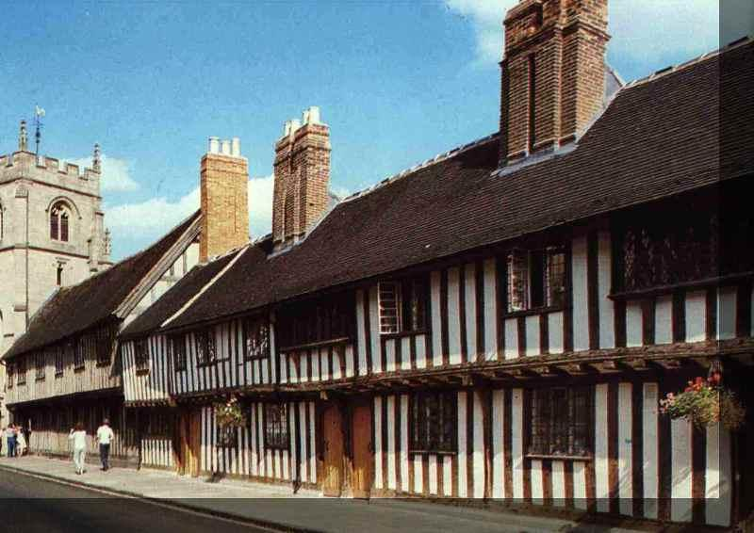
W. SHAKESPEARE’S SCHOOL IN STRATFORD-UPON-AVON

Slide 10
THE CLASSROOM

Slide 11
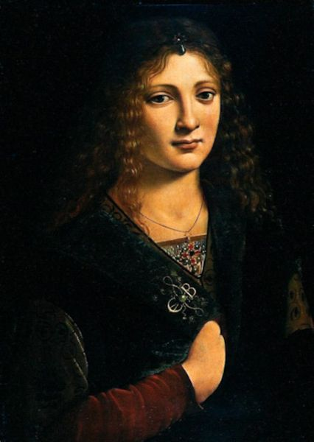
◆ Married Anne Hathaway in 1582
◆ Anne was 26, he was 18
◆ 3 children
◆ The youngest, Hamnet died at the age of 11

Slide 12
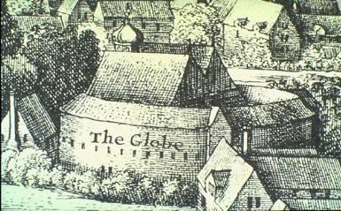
London
MOVED TO WORK IN LONDON AT THE AGE OF 23
JOINED A TRAVELLING COMPANY OF ACTORS
WORKED AS AN ACTOR AND A WRITER
MOST OF HIS PLAYS WERE PERFORMED IN THE NEW GLOBE THEATRE

Slide 13
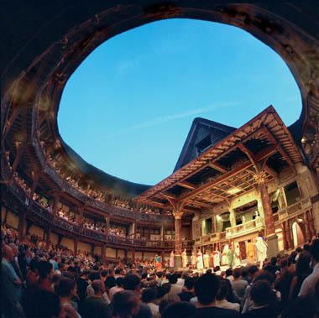
THE FIRST SHAKESPEARE’S GLOBE THEATRE

Slide 14
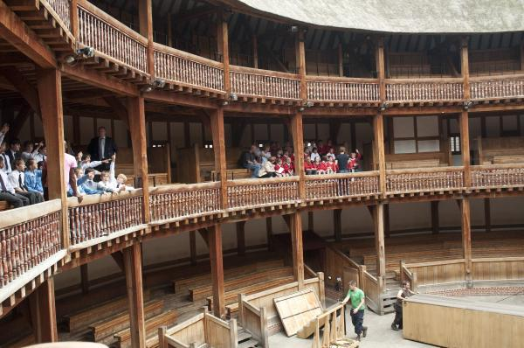

Slide 15
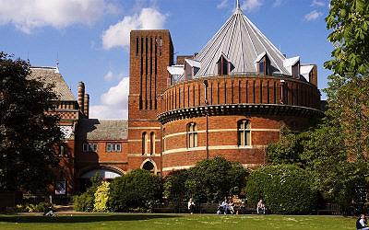
STRATFORD ROYAL SHAKESPEARE THEATRE (1932)

Slide 16
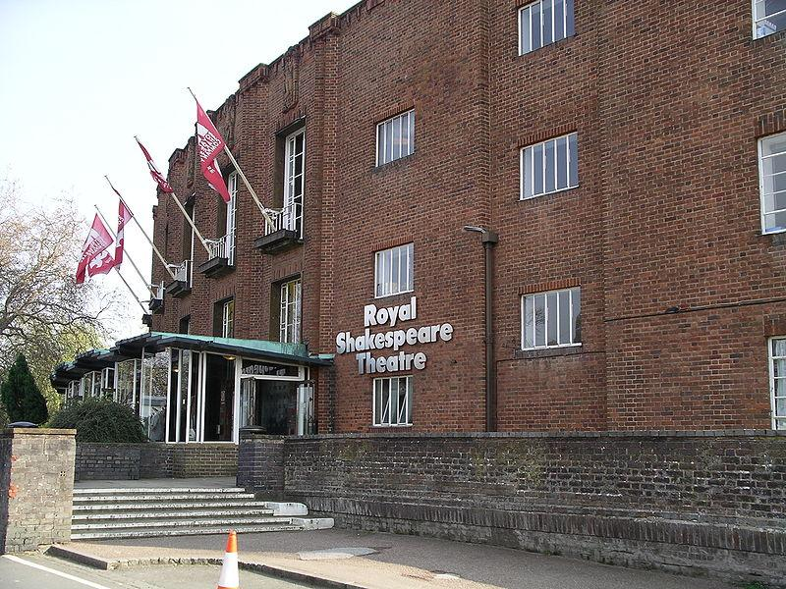

Slide 17
THESE GREAT SHAKESPEARE’ S PLAYS ARE KNOWN ALL OVER THE WORLD
1593 «THE COMEDY OF ERRORS»
1595 «ROMEO AND JULIET»
1599 «JULIUS CAESAR»
1600 «AS YOU LIKE IT»
1600 «TWELFTH NIGHT»
1601 « HAMLET»
1604 «OTHELLO»
1606 «KING LEAR»
and others

Slide 18
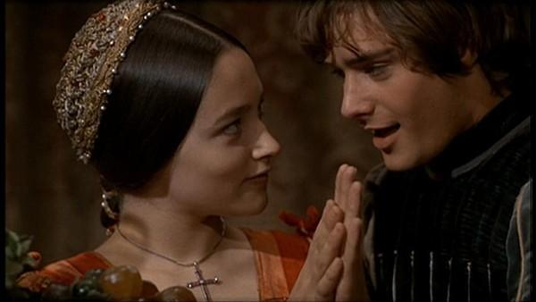
ROMEO AND JULIET

Slide 19
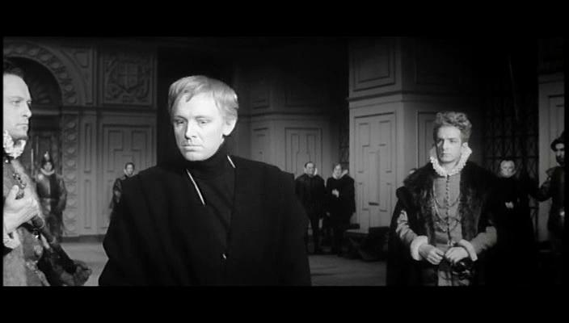
HAMLET

Slide 20
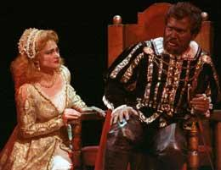
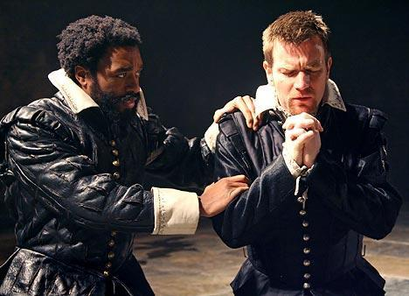
OTHELLO

Slide 21
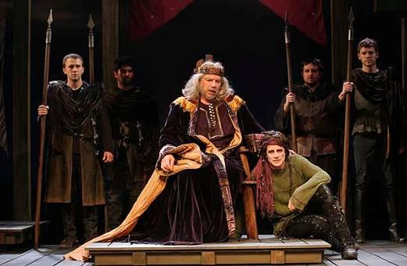
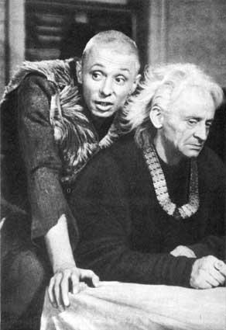
KING LEAR

Slide 22
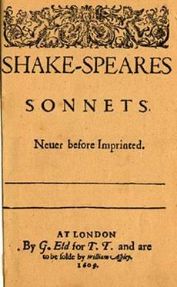
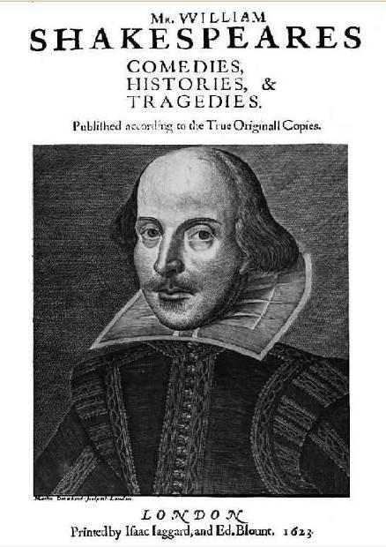
1609
1623

Slide 23
SHAKESPEARE’S SIGNATURE

Slide 24
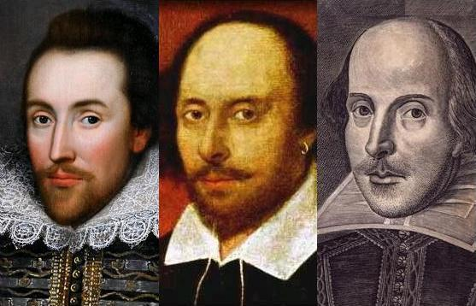
THERE ARE SEVERAL SHAKESPEARE’S POTRAITS
Which is real? Nobody knows…

Slide 25
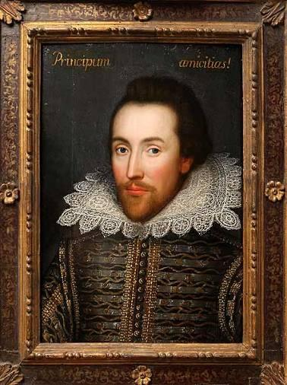
A NEW POTRAIT WAS FOUND
1610
Shakespeare is here 46 YEARS OLD

Slide 26
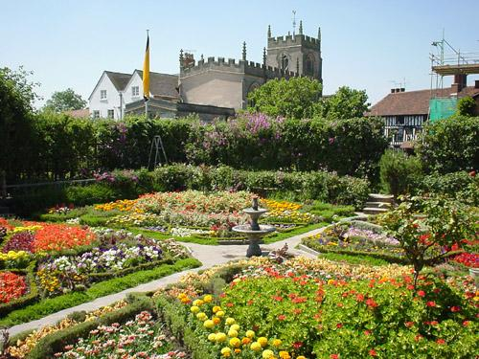
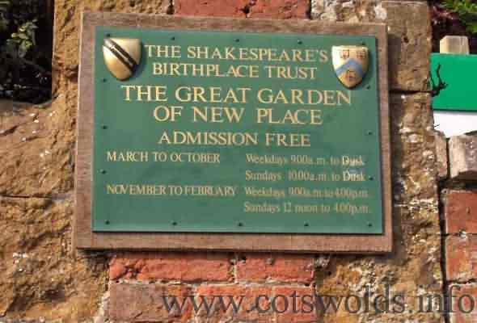
HERE W. SHAKESPEARE SPENT HIS LAST YEARS. THE HOUSE WAS DESTROYED. THERE IS A GARDEN ON ITS PLACE.

Slide 27
By the end of his life
Returned to Stratford 1610
1616 Shakespeare died on April, 23 (on his birthday)

Slide 28
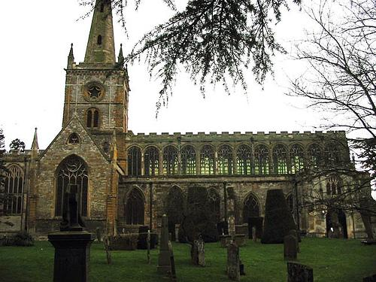
HOLY TRINITY CHURCH IN STRATFORD
This Great man was buried in Holy Trinity Church, where he was christened

Slide 29
HOLY TRINITY CHURCH THE FIRST MONUMENT

Slide 30
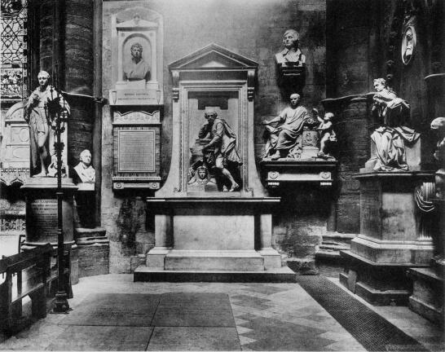
THERE IS A POET’S CONER IN WESTMINSTER ABBY

Slide 31
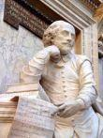
ONLY IN 1740, 124 YEARS AFTER HIS DEATH, MEMORIAL STATUE TO WILLIAM SHAKESPEARE WAS ERECTED IN THIS CORNER.

Slide 32
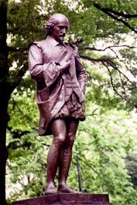
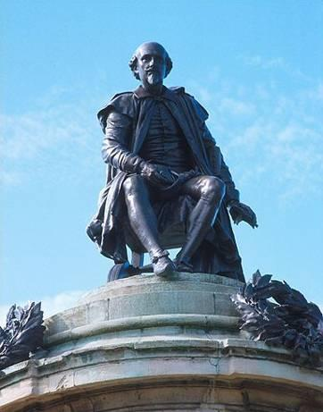
THE ARE SEVERAL SHAKESPEAR’S MONUMENTS
STRATFORD ON AVON
NEW YORK

Slide 33
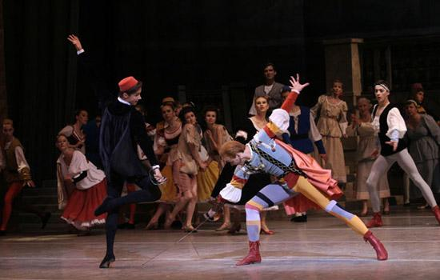
THOUGH WRITTEN MORE THAN 400 YEARS AGO, HIS PLAYS CONTINUE TO BE READ AND PERFORMED.

Slide 34
FINALLY I SHOULD SAY
W. Shakespeare wrote:
37 plays
154 sonnets
2 poems

Slide 35
«HE WAS NOT FOR AN AGE, BUT FOR ALL TIME.» Ben Jonson (1572-1637)

