Slide 1
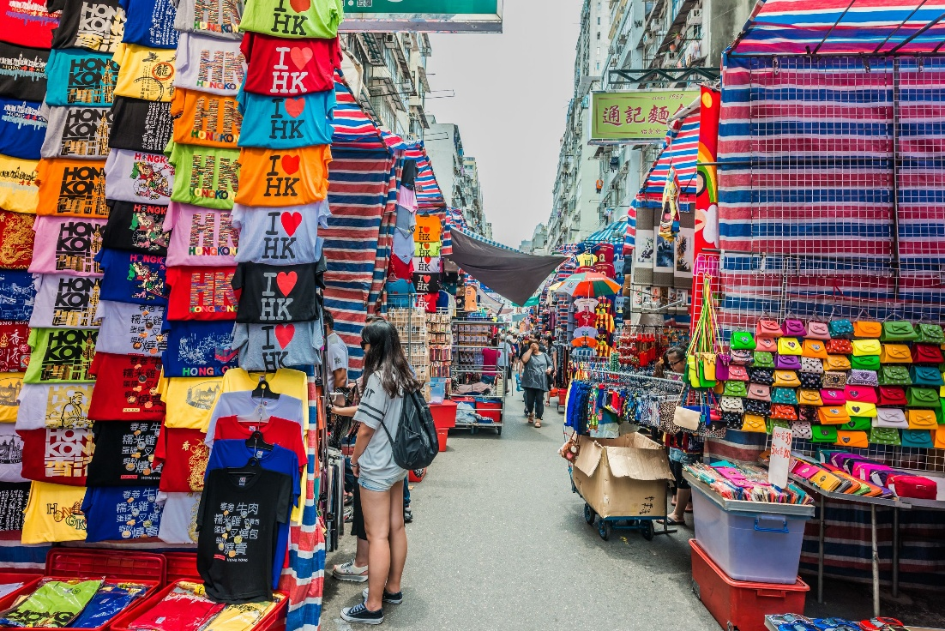
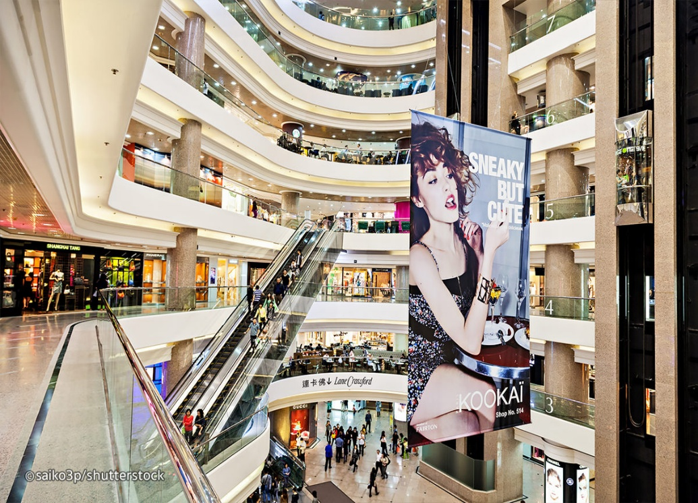
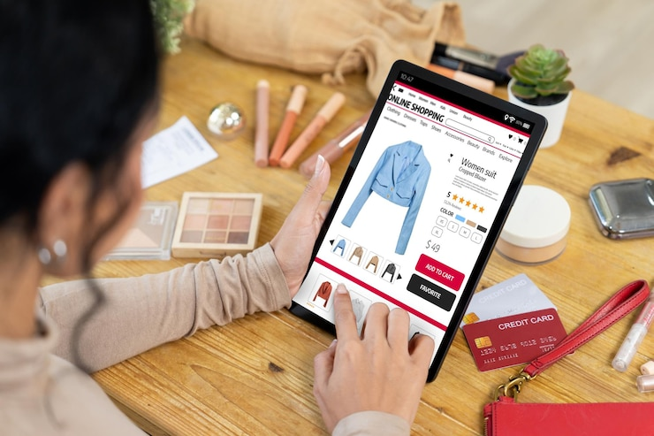
What is the topic
of our lesson?
SHOPPING

Slide 2
Translate these English words into Russian:
bargain
brands
special offer
logo
deal
whim
discount
budget
выгодная покупка
бренды
спецпредложение
логотип
сделка
прихоть, каприз
скидка
бюджет

Slide 3
Read these sentences and put the words from the box:
brands special offer bargain discount whim deal logo budget
Look at this! If you buy two of these today you get a third one free. What a _____!
She always wears the latest in designer footwear. If it hasn't got the _____of one of the most famous_____ she isn't interested.
Normally I plan what I'm going to buy but yesterday I suddenly saw this and without thinking bought it on a ____ . Now I'm not sure that I like it.
We have a ____so we know exactly how much we can spend each month and we can't go over it.
This was on ____ for one week only. It had 50% off so I bought it!
He made a _____with us that if we bought the car there and then, he'd give it a free service at the end of the first year.
I can give you a _____ 10% if you pay for it in cash.

Slide 4
Look at this! If you buy two of these today you get a third one free. What a bargain!
She always wears the latest in designer footwear. If it hasn't got the logo of one of the most famous brands she isn't interested.
Normally I plan what I'm going to buy but yesterday I suddenly saw this and without thinking bought it on a whim . Now I'm not sure that I like it.
We have a budget so we know exactly how much we can spend each month and we can't go over it.
This was on special offer for one week only. It had 50% off so I bought it!
He made a deal with us that if we bought the car there and then, he'd give it a free service at the end of the first year.
I can give you a 10% discount if you pay for it in cash.

Slide 5
Read the text below. Use the words given in capitals to form a word that fits the gap.
Big stores vs. small shops
There is a great excitement about going into a huge department store and seeing such an ¹⁾___ (BELIEVE) range of things to buy. Department stores are almost like ²⁾ ___ (GLAMOUR) villages where you can stay all day and eat and drink. It is almost a modern form of ³⁾ ____ (ENTERTAIN) and everything looks so wonderful that they definitely encourage impulse ⁴⁾ ___ (SHOP). A very common trend at the moment is for huge stores ⁵⁾ ____ (SPECIAL) in one product such as sports clothes or computers. There are also stores which sell ⁶⁾ ________ (NUMBER) products from one source, such as the Disney stores. The noise and size of these large stores can be overwhelming and many people prefer to shop in small boutiques that sell different or ⁷⁾_____ (USUAL) things that they can't find anywhere else. The ⁸⁾ ________ (DIFFICULT) here is that you may be the only person in the shop so it can make you feel ⁹⁾ ______(COMFORT) while you are looking around. However, you may prefer the personal service in these shops, where it is truly shopping as it used to be.

Slide 6
1 unbelievable
2 glamorous
3 entertainment
4 shopping
5 specialising
6 numerous
7 unusual
8 difficulty
9 uncomfortable

Slide 7
Fill in the gaps with the correct prepositions:
at / behind / down / Instead of / in / in / in of / of / on / out of / to / with
Nobody can deny that supermarkets are very convenient. The whole idea ⁽¹⁾__ them is that they give customers more choice ⁽²⁾___ a cheaper price. But the current fashion ⁽³⁾_____ building enormous supermarkets ⁽⁴⁾____ the outskirts of towns is having the opposite effect. These supermarkets are putting small shopkeepers ⁽⁵⁾____ business. Shops ⁽⁶⁾____ town centres are closing ⁽⁷⁾____ because they cannot compete ⁽⁸⁾___ the low prices the big supermarkets are able to offer their customers. Town centres are dying.
⁽⁹⁾_______ shopping in town, people are driving ⁽¹⁰⁾___ the out-of-town supermarkets, buying all the food they need for a week or two, then driving home again. That is their choice. But soon they will have no choice ⁽¹¹⁾__ the matter, because all ⁽¹²⁾____ the shops in their town will have closed down. This is why some town councils are refusing to give supermarket chains permission to build ⁽¹³⁾___ their region. Nobody wants to live in a ghost town.

Slide 8
Nobody can deny that supermarkets are very convenient. The whole idea 1.behind them is that they give customers more choice 2.at a cheaper price. But the current fashion 3.of building enormous supermarkets 4.on the outskirts of towns is having the opposite effect. These supermarkets are putting small shopkeepers 5.out of business. Shops 6.in town centres are closing 7.down because they cannot compete 8.with the low prices the big supermarkets are able to offer their customers. Town centres are dying.
9.Instead of shopping in town, people are driving 10.to the out-of-town supermarkets, buying all the food they need for a week or two, then driving home again. That is their choice. But soon they will have no choice 11.in the matter, because all 12. of the shops in their town will have closed down. This is why some town councils are refusing to give supermarket chains permission to build 13. in their region. Nobody wants to live in a ghost town.

