Slide 1
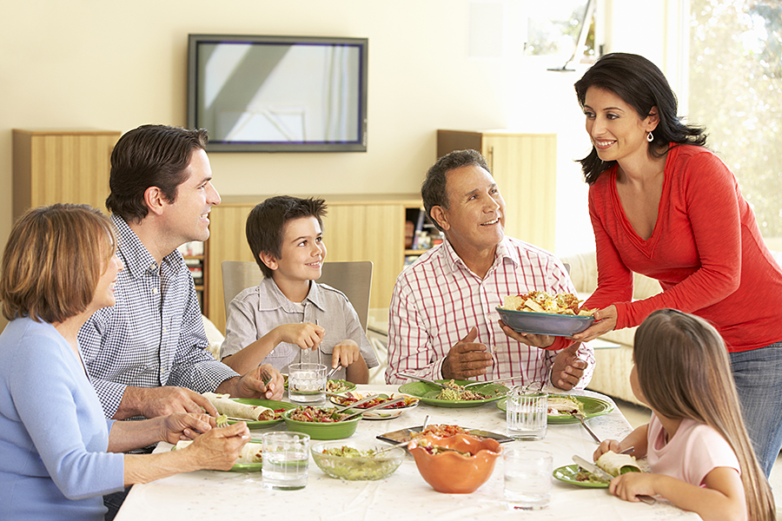
Look at the picture and call out 5–10 words that come to mind

Slide 2
Прочитайте приведённые ниже предложения. Образуйте от слов, напечатанных заглавными буквами обозначенных номерами 1–9, однокоренные слова так, чтобы они грамматически и лексически соответствовали содержанию. Заполните пропуски полученными словами.
The family meal time is one of the most ________(1. VALUE) routines to establish in the life of a family.
They learn simply and directly through their own experience, the _______________________(2. IMPORTANT) of family interactions and the value of close friendship, support and _____(3. LOYAL).
A shared meal can be the setting for _______(4. PEACE) conversation.
__________(5. SUCCESS) family meal times are primarily about talking and _______________(6. COMMUNICATE).
There are ________(7.VARY) strategies available for promoting shared family meals.
Our lives really can be better in general if we make the effort to communicate more _________(8. EFFECT).
There will always be _________(9. ARGUE) from time to time.
They can also help by being _______(10. ATTENTION) listeners and appropriate _________(11. RESPOND).

Slide 3
Прочитайте приведённые ниже предложения. Образуйте от слов, напечатанных заглавными буквами обозначенных номерами 1–9, однокоренные слова так, чтобы они грамматически и лексически соответствовали содержанию. Заполните пропуски полученными словами.
The family meal time is one of the most valuable routines to establish in the life of a family.
They learn simply and directly through their own experience, the importance of family interactions and the value of close friendship, support and loyalty.
A shared meal can be the setting for peaceful conversation.
Successful family meal times are primarily about talking and communication.
There are various strategies available for promoting shared family meals.
Our lives really can be better in general if we make the effort to communicate more effectively.
There will always be arguments from time to time.
They can also help by being attentive listeners and appropriate responders.

Slide 4
Прочитайте текст и заполните пропуски A–F частями предложений, обозначенными цифрами 1–7. Одна из частей в списке 1–7 лишняя. Занесите цифру, обозначающую соответствующую часть предложения, в таблицу.
The family meal time is one of the most valuable routines _____A. Research has proved _______B with their families benefit greatly in terms of social skills and acceptance of shared responsibilities. They learn simply and directly _______C, the importance of family interactions and the value of close friendship, support and loyalty.
In theory and with practice, a shared meal can be the setting for peaceful conversation and allow each family member the opportunity to talk about his/her day, ___D. Successful family meal times are primarily about talking and communication. In the modern age of 24 hour TV, computer games and computer social networking sites – the fact is ___E rather than together. Furthermore, if parents fail to establish these routines __F it is very hard to implement them when the kids become teenagers. But it is not impossible. There are various strategies available for promoting shared family meals.
1. and possibly to discuss any problems or issues
2. that children who eat at least one meal a week
3. to establish in the life of a family
4. that it is often easier to eat alone
5. that share family’s values
6. whilst their children are young
7. through their own experience
A | B | C | D | E | F

Slide 5
The family meal time is one of the most valuable routines to establish in the life of a family. Research has proved that children who eat at least one meal a week with their families benefit greatly in terms of social skills and acceptance of shared responsibilities. They learn simply and directly through their own experience, the importance of family interactions and the value of close friendship, support and loyalty.
In theory and with practice, a shared meal can be the setting for peaceful conversation and allow each family member the opportunity to talk about his/her day, and possibly to discuss any problems or issues. Successful family meal times are primarily about talking and communication. In the modern age of 24 hour TV, computer games and computer social networking sites – the fact is that it is often easier to eat alone rather than together. Furthermore, if parents fail to establish these routines whilst their children are young it is very hard to implement them when the kids become teenagers. But it is not impossible. There are various strategies available for promoting shared family meals.
1. and possibly to discuss any problems or issues
2. that children who eat at least one meal a week
3. to establish in the life of a family
4. that it is often easier to eat alone
5. that share family’s values
6. whilst their children are young
7. through their own experience
A | B | C | D | E | F
3 | 2 | 7 | 1 | 4 | 6

Slide 6
DISCUSS IN PAIRS
What are the main values which children acquire thanks to family meals?
What is the ideal family meal?
Why may teenagers not want to join a family meal?
Is it late to start the tradition of family meals if the children are quite old?

Slide 7

Task 4. Imagine that you and your friend are doing a school project “Family Pastime”. You have found some photos to illustrate it but for technical reasons you cannot send them now. Leave a voice message to your friend explaining your choice of the photos and sharing some ideas about the project. In 2.5 minutes be ready to:
• explain the choice of the illustrations for the project by briefly describing them and noting the differences;
• mention the advantages (1–2) of the two ways of spending family pastime;
• mention the disadvantages (1–2) the two ways of spending family pastime;
• express your opinion on the subject of the project – which way of spending family pastime you’d prefer and why.
You will speak for not more than 3 minutes (12–15 sentences). You have to talk continuously.

