Slide 1
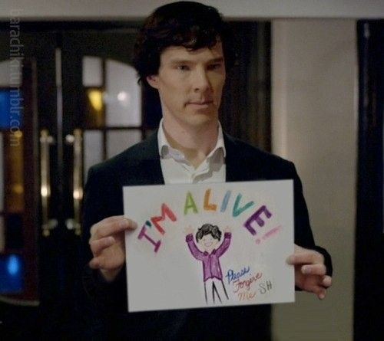
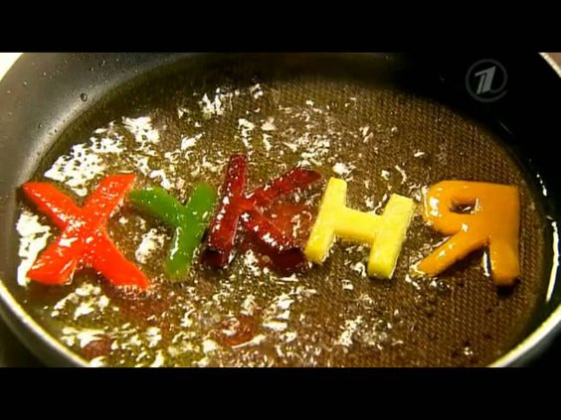
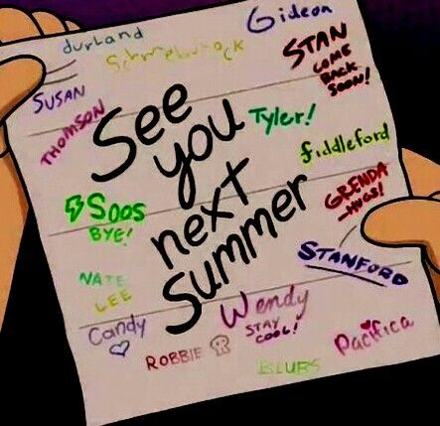
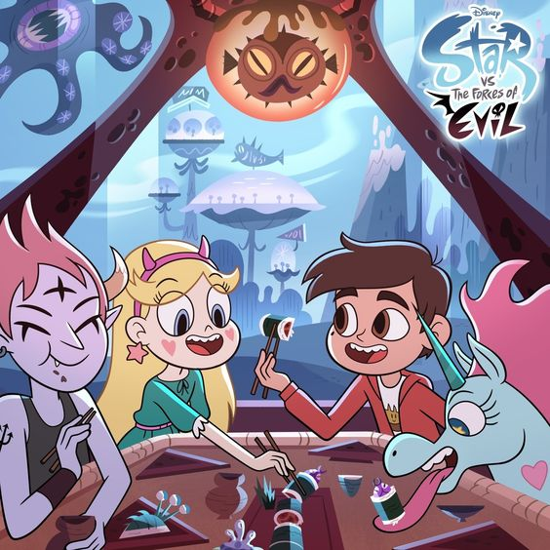
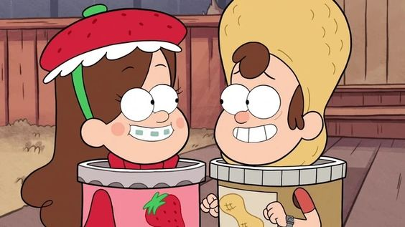
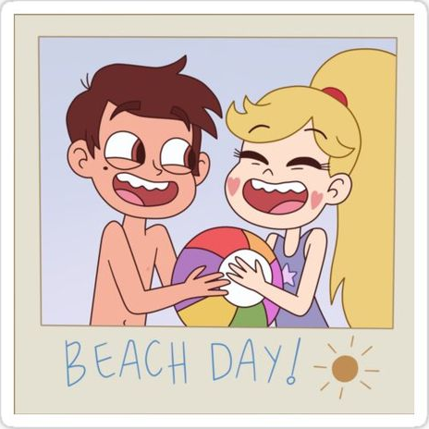
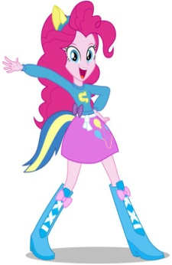
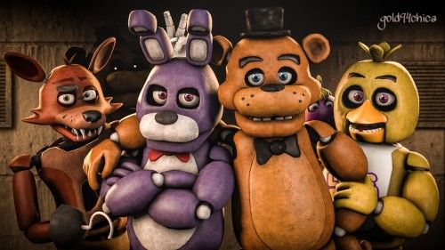
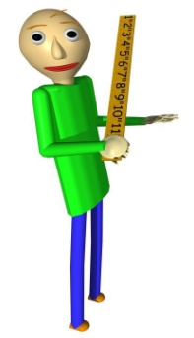
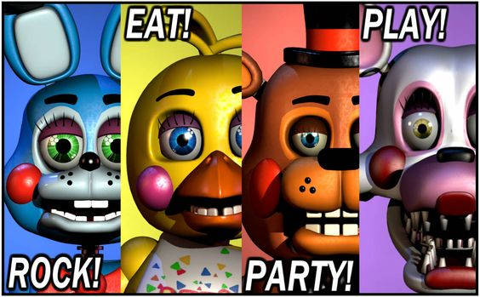
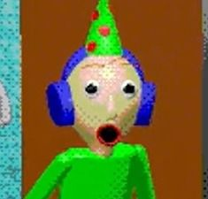
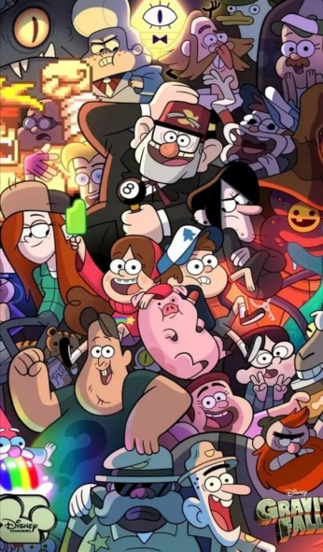
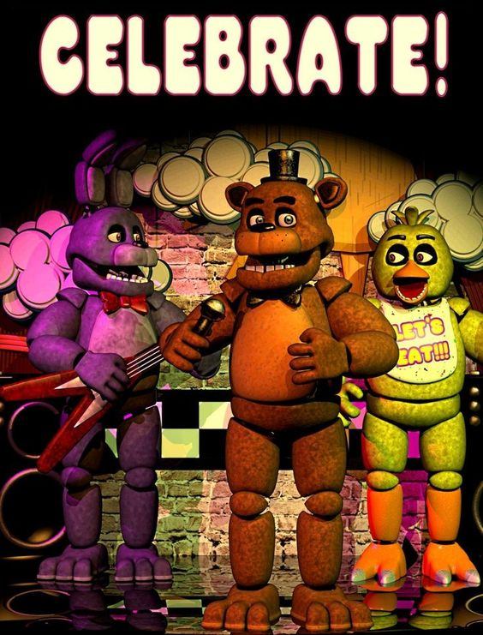
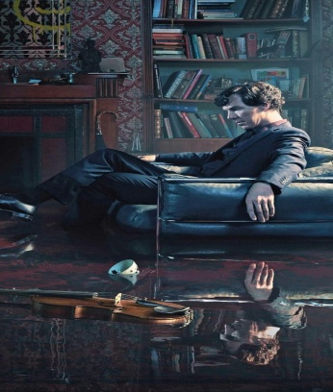
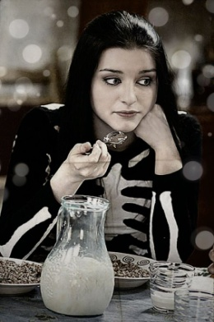
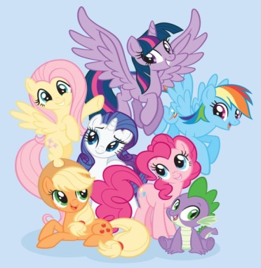

Slide 3
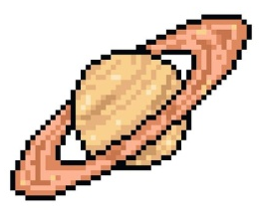
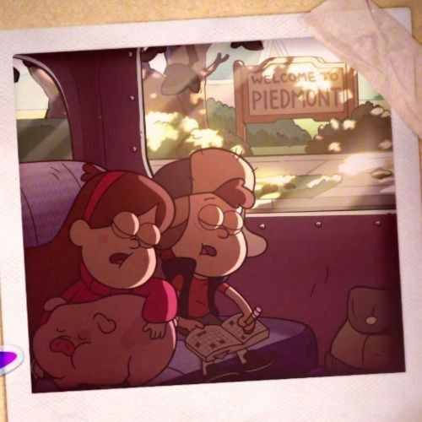
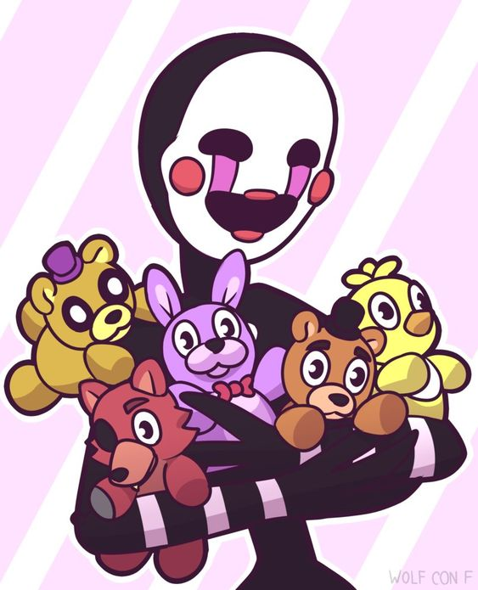
CARTOONS
GAMES

Slide 4
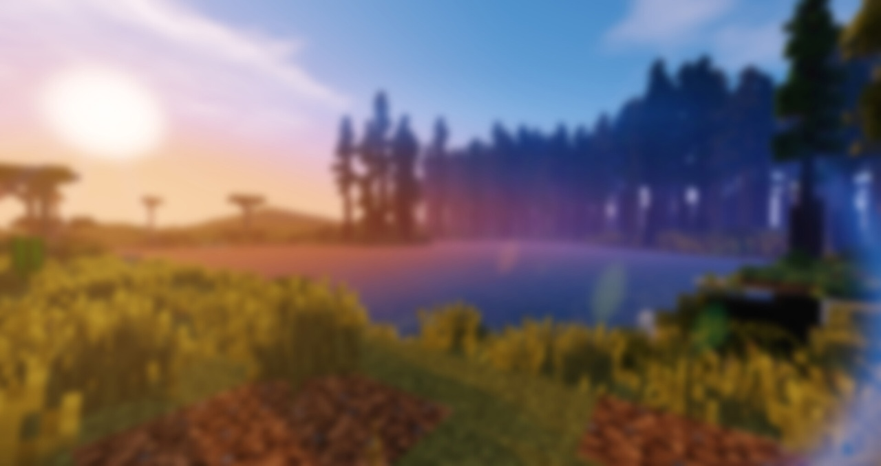
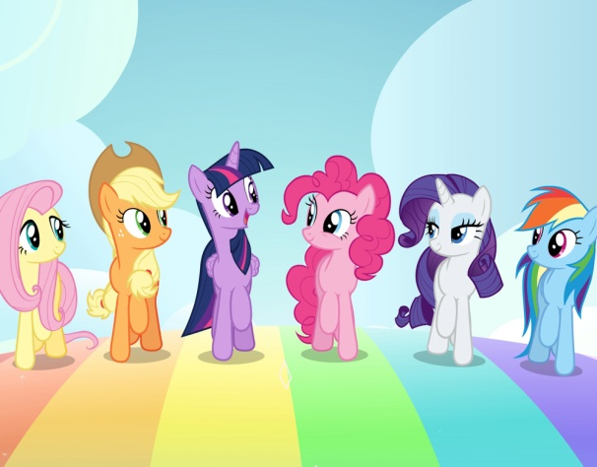
MY LITTLE PONY: FRIENDSHIP IS MAGIC
GRAVITY FALLS

Slide 5
CARTOONS
GAMES

Slide 6
CARTOONS
GAMES

Slide 7
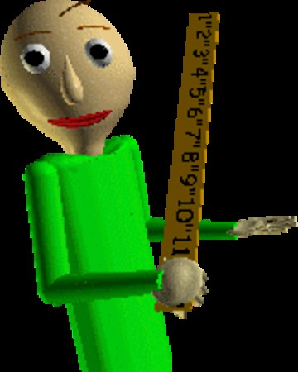
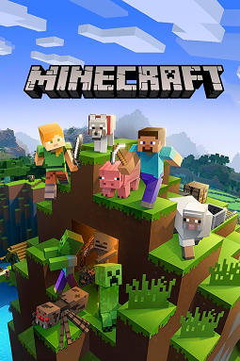
FIVE NIGHTS AT FREDDY’S
BALDI’S BASICS IN EDUCATION AND LEARNING
MINECRAFT

Slide 8
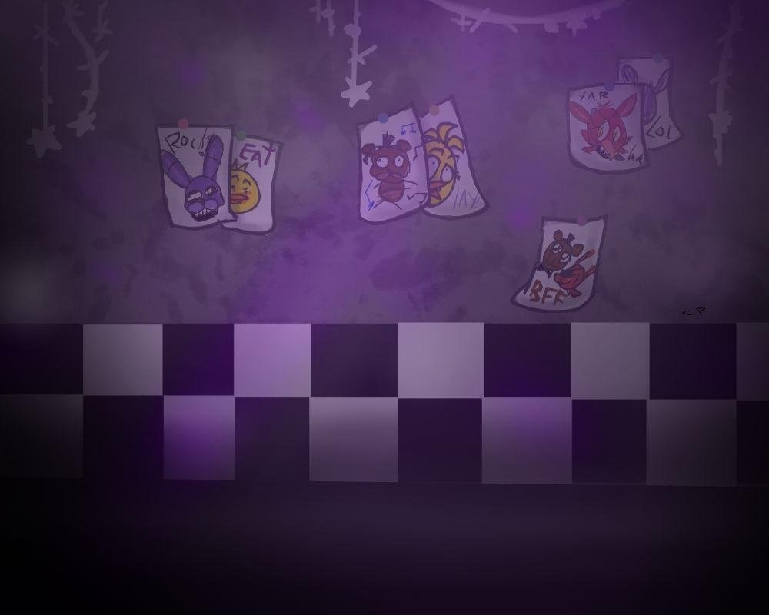
FIVE NIGHTS AT FREDDY’S
Here is a terrible story of FNAF. Put the words in the text in the correct form, otherwise Foxy will eat you.
The crying boy incident... (occur) in 1983. During the week before his brother's birthday, Michael Afton... (bully) him in every possible way. On his birthday, Michael and his friends decided... (play) a prank and put the little boy in the Fredbear's mouth. The boy... (cry), so the animatronic's springs broke. After incident 83 the pizzeria... (close).

Slide 9
FIVE NIGHTS AT FREDDY’S
The crying boy incident... (occur) in 1983.

Slide 11
FIVE NIGHTS AT FREDDY’S
The crying boy incident occurred in 1983.

Slide 12
FIVE NIGHTS AT FREDDY’S
During the week before his brother's birthday, Michael Afton... (bully) him in every possible way.

Slide 14
FIVE NIGHTS AT FREDDY’S
During the week before his brother's birthday, Michael Afton had been bullying him in every possible way.

Slide 15
FIVE NIGHTS AT FREDDY’S
On his birthday, Michael and his friends decided... (play) a prank and put the little boy in the Fredbear's mouth.

Slide 17
FIVE NIGHTS AT FREDDY’S
On his birthday, Michael and his friends decided to play a prank and put the little boy in the Fredbear's mouth.

Slide 18
FIVE NIGHTS AT FREDDY’S
The boy... (cry), so the animatronic's springs broke.

Slide 20
FIVE NIGHTS AT FREDDY’S
The boy was crying, so the animatronic's springs broke.

Slide 21
FIVE NIGHTS AT FREDDY’S
After incident 83 the pizzeria... (close).

Slide 23
FIVE NIGHTS AT FREDDY’S
After incident 83 the pizzeria was closed.

Slide 24
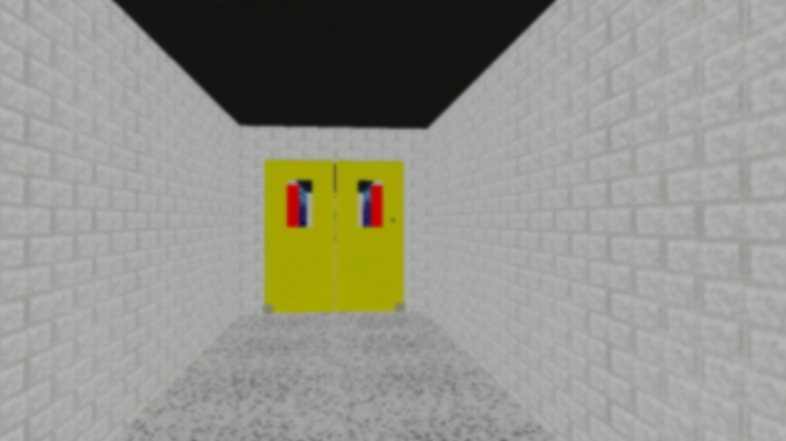
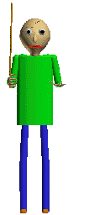
BALDI’S BASICS IN EDUCATION AND LEARNING
Did you think that you would avoid Maths in English class? It won't work, Baldi's out hunting. Write the numbers in letters and give an answer.
14+48=
15-5=
9×90=
72:4=

Slide 25
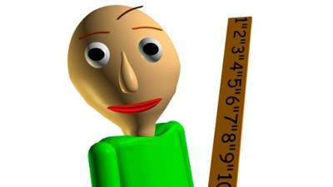
BALDI’S BASICS IN EDUCATION AND LEARNING
14+48=62 fourteen plus forty eight equals sixty two
15-5=10 fifteen minus five equals ten
9×90=810 nine times ninety equals eight hundred and ten
72:4=18 seventy two divided by four equals eighteen

Slide 26
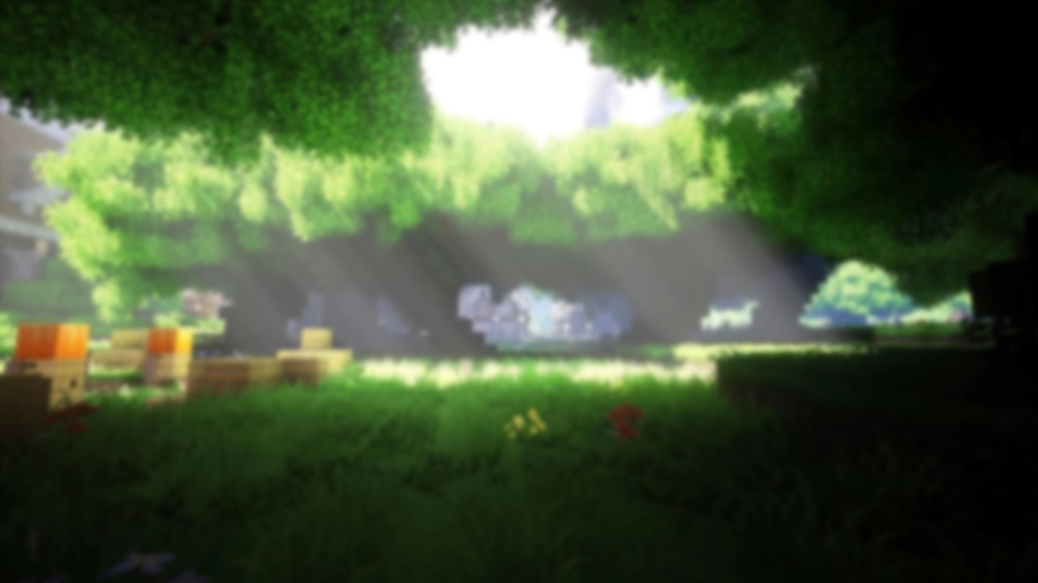
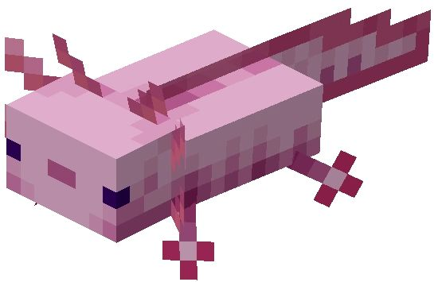
MINECRAFT
Spiders, skeletons, zombies, endermen and creepers...No, it's not a horror game, it's just Minecraft. Using comparative and superlative forms of adjectives, compare mobs, blocks and objects.

Slide 27
MINECRAFT

Slide 28
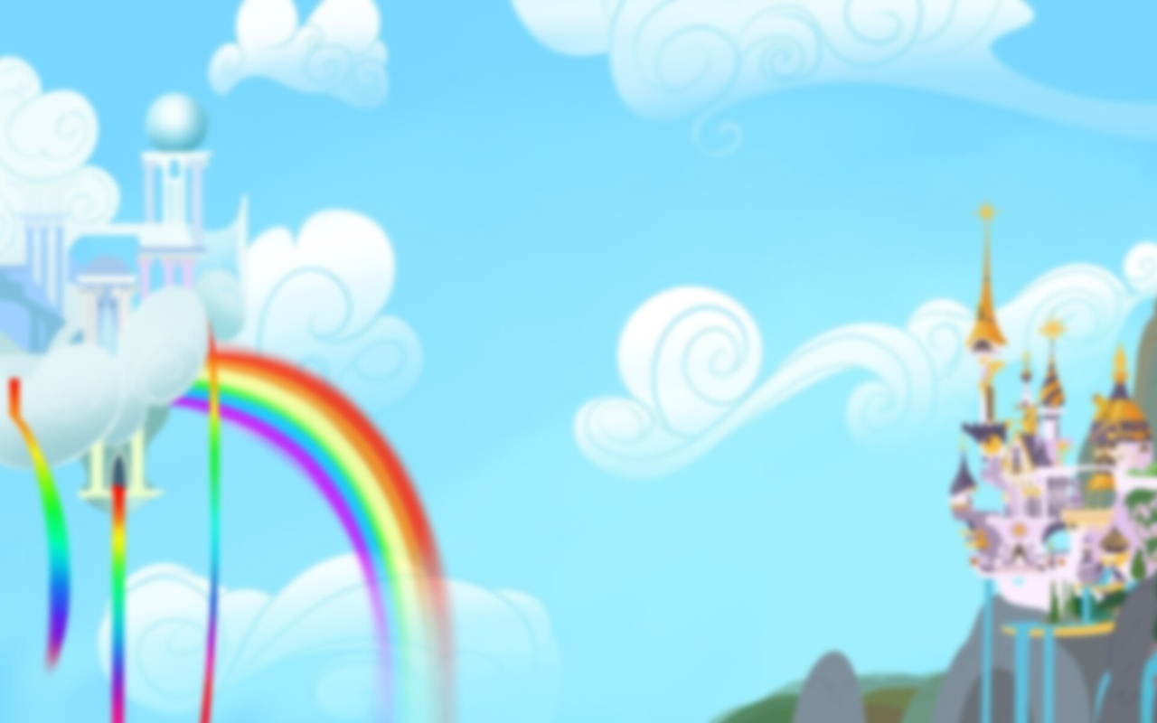
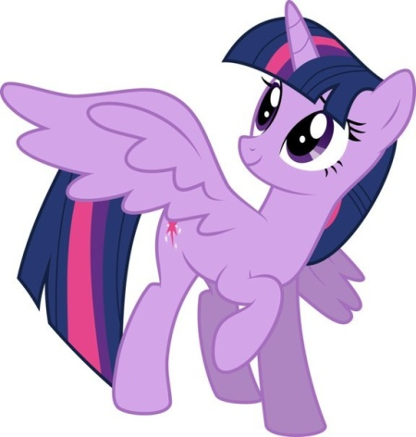
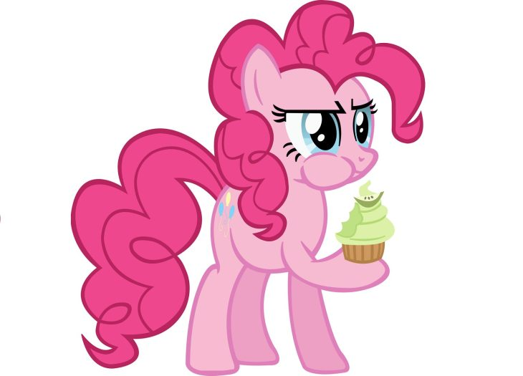
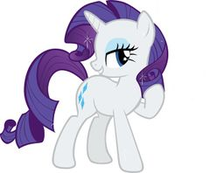
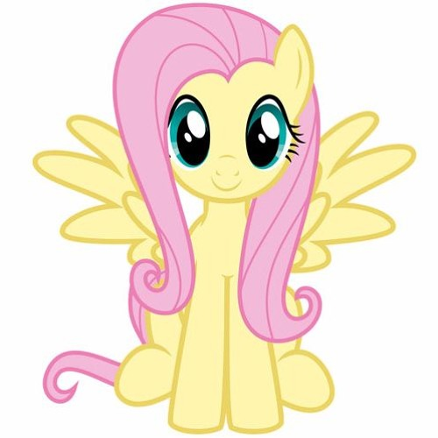
MY LITTLE PONY: FRIENDSHIP IS MAGIC
TWILIGHT SPARKLE
RAINBOW DASH
PINKIE PIE
RARITY
FLUTTERSHY
APPLEJACK

Slide 29
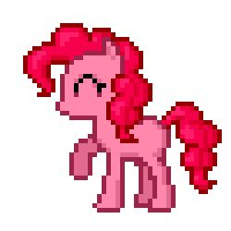
MY LITTLE PONY: FRIENDSHIP IS MAGIC
My Little Pony...do you also have a song playing in your head? Your task is to describe your favorite pony without naming it, and others will try to guess.

Slide 30
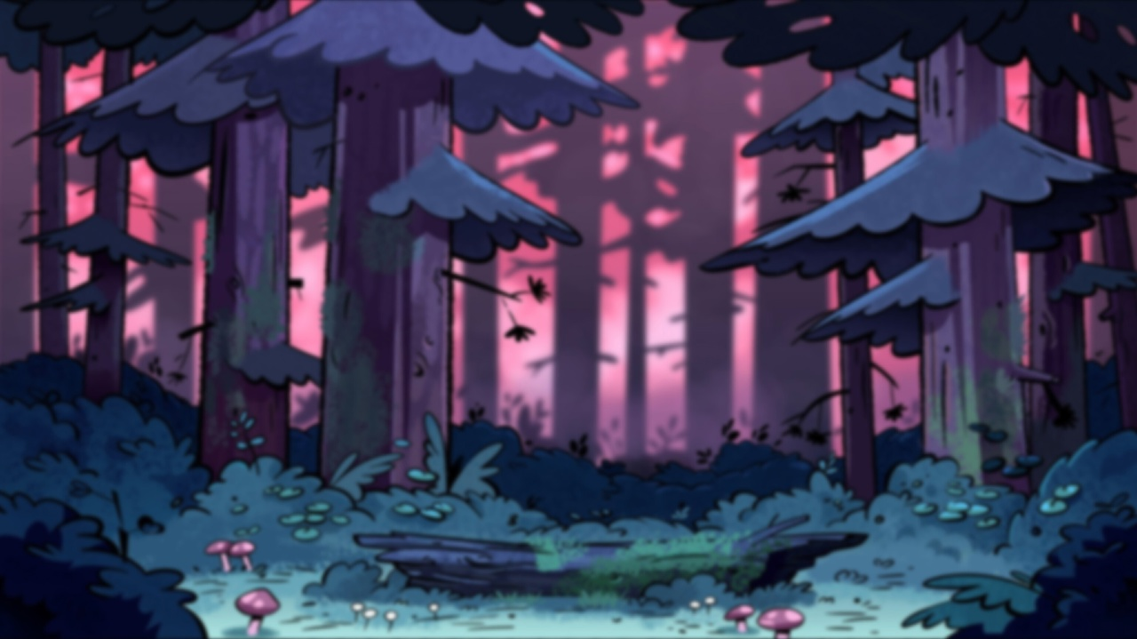
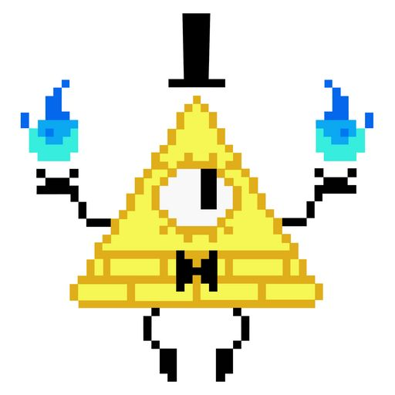
GRAVITY FALLS
The cartoon Gravity Falls, beloved by many, is full of secrets. Take even Bill Cipher, he is the most powerful triangle in the world with one eye and a cylinder on top. Watch a series about an unusual mailbox and answer the questions.

Slide 31
GRAVITY FALLS

Slide 32
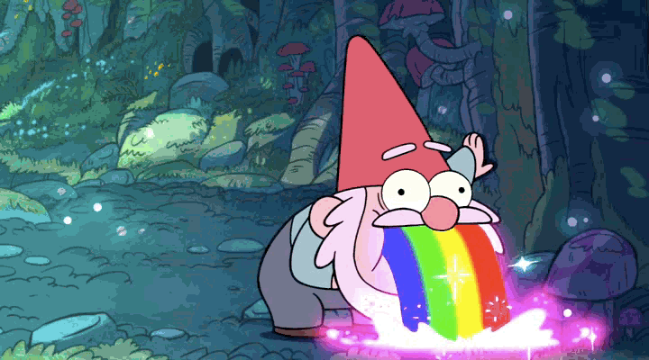
GRAVITY FALLS
1. What is the anomaly number?
44
14
74
54

Slide 33
GRAVITY FALLS
1. What is the anomaly number?
44
14
74
54

Slide 34
GRAVITY FALLS
2. What did Soos write in the first letter?
Sup dawg?
Hi:)
Let's talk F2F?
When is the end of the world?

Slide 35
GRAVITY FALLS
2. What did Soos write in the first letter?
Sup dawg?
Hi:)
Let's talk F2F?
When is the end of the world?

Slide 36
GRAVITY FALLS
3. What did Soos shave on his head in the morning?
Circle
Person
Duck with a racket and a ball
Cat

Slide 37
GRAVITY FALLS
3. What did Soos shave on his head in the morning?
Circle
Person
Duck with a racket and a ball
Cat

Slide 38
GRAVITY FALLS
4. According to the mailbox, when will the world end?
3012
3022
2212
4012

Slide 39
GRAVITY FALLS
4. According to the mailbox, when will the world end?
3012
3022
2212
4012

Slide 40
GRAVITY FALLS
5. What did Mabel want to send to Mom?
100 sweaters
Waddles
100 packs of marmalade
A video where she puts 100 marmalades in her nose

Slide 41
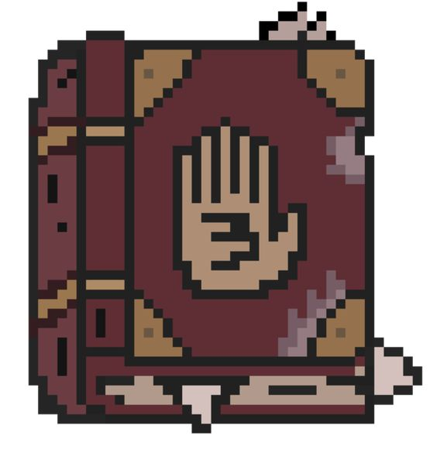
GRAVITY FALLS
5. What did Mabel want to send to Mom?
100 sweaters
Waddles
100 packs of marmalade
A video where she puts 100 marmalades in her nose

Slide 42
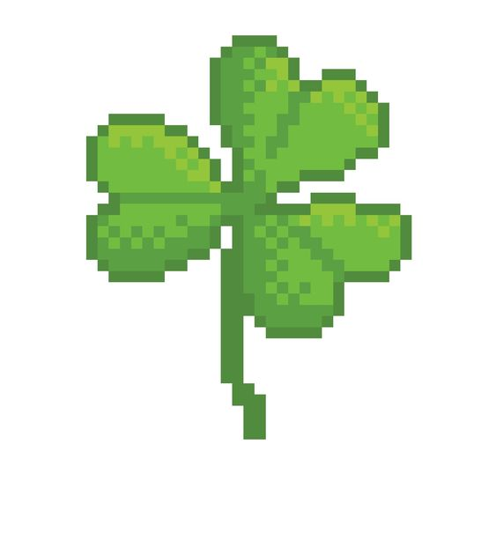
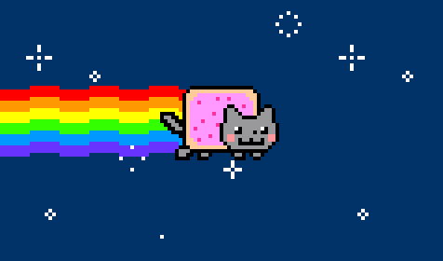
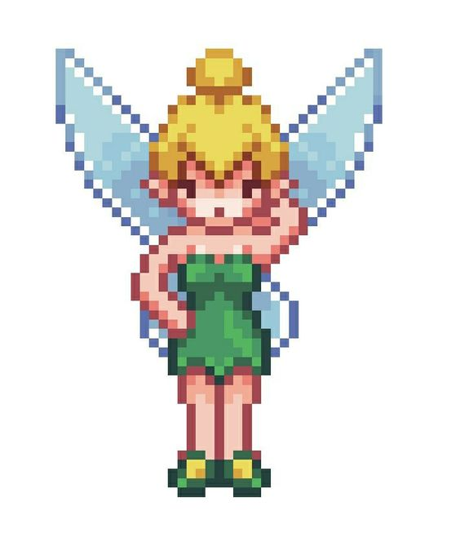
THANKS FOR YOUR

