Slide 1








[ð]-[ð]-[ð]
[z]-[z]-[z]
[f]-[f]-[f]
[w]-[w]-[w]
[t]-[t]
[d]-[d]
[nei]-[nei]-[nei]

Slide 2
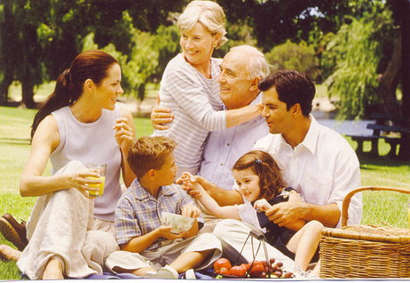

Slide 3
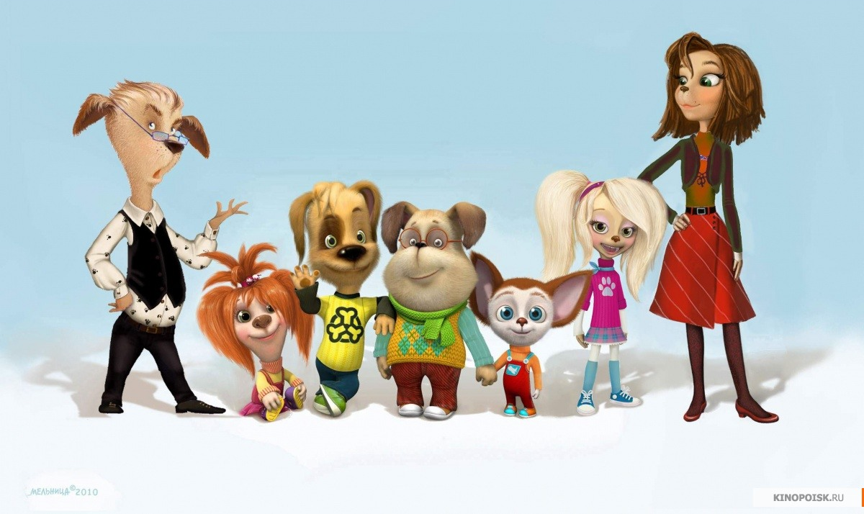

Slide 4


Slide 5
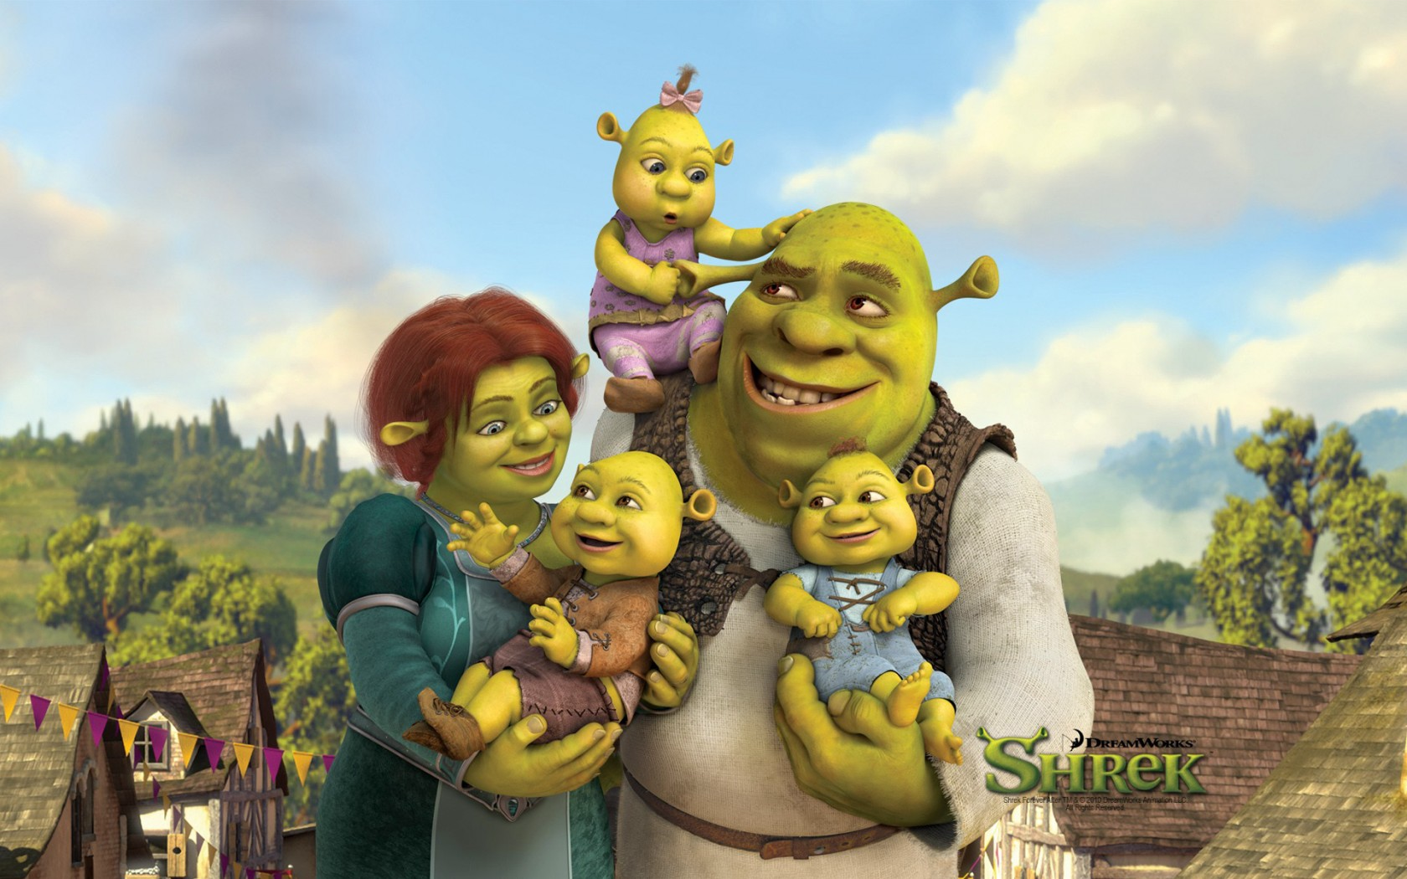

Slide 6
FILL UP THE GAPS
f...mily
m...ther
f...ther
grandm...ther
grandf...ther
s...ster
br...ther

Slide 7
FIND 6 FAMILY-WORDS
M | O | T | H | E | R | F | S | B | X | F
D | D | B | I | L | X | A | I | W | M | A
M | X | Z | R | P | D | X | S | M | C | T
Q | W | E | R | T | Y | U | T | O | A | H
S | D | B | R | O | T | H | E | R | G | E
Y | W | C | F | B | Z | X | R | C | V | R
B | N | M | Q | W | D | F | Y | N | E | X
G | R | A | N | D | F | A | T | H | E | R
Q | X | A | X | J | U | M | W | V | M | T
W | A | Z | Z | F | D | C | H | U | O | P
G | R | A | N | D | M | O | T | H | E | R

Slide 8
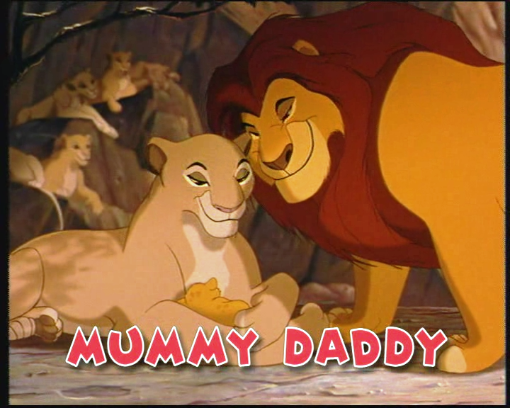

Slide 9


Slide 10
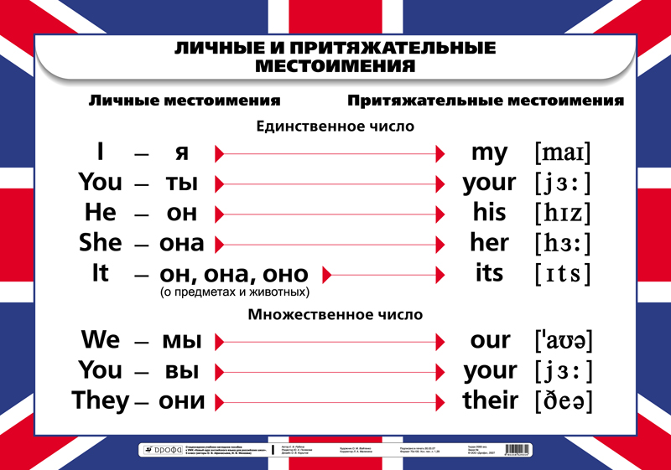

Slide 11
I My
You Your
He His
She Her
It Its
We Our
They Their

Slide 12
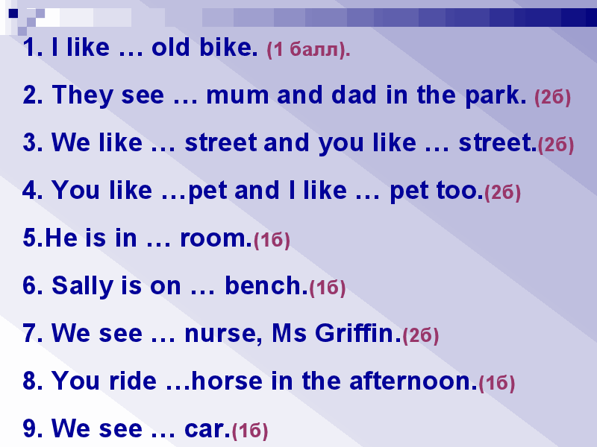

Slide 13
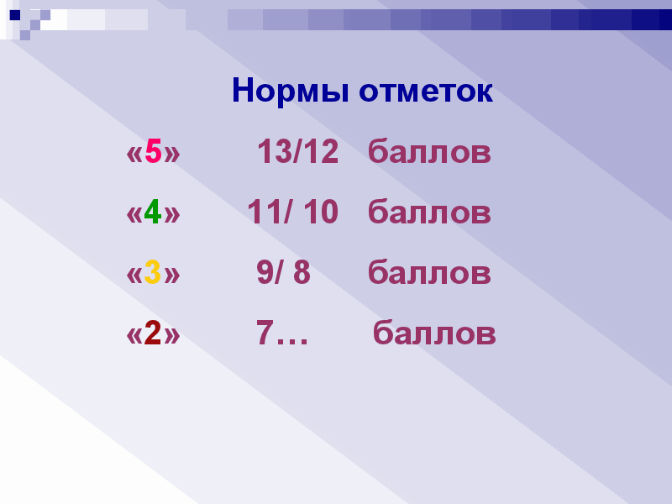

Slide 14


Slide 15
