Slide 1
B
C
D
E
F
A
G
Word game
H
W
X
Y
Z
V
I
26
U
J
T
K
S
L
R
Q
M
P
O
N

Slide 2
Score
A
B
C
D
E
1
F
G
H
I
J
2
K
L
M
N
O
3
P
Q
R
S
T
4
U
V
W
X
Y Z
5

Slide 3
A
Someone who plays
at the theatre.

Slide 4
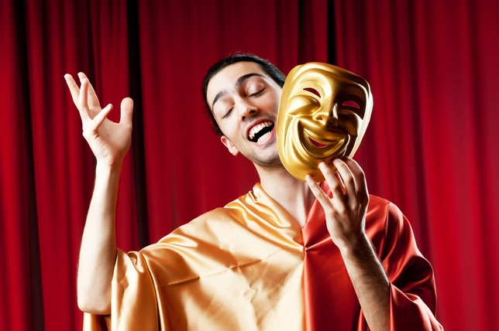
1
Actor

Slide 5
B
The official residence
of the royal family
in London .

Slide 6
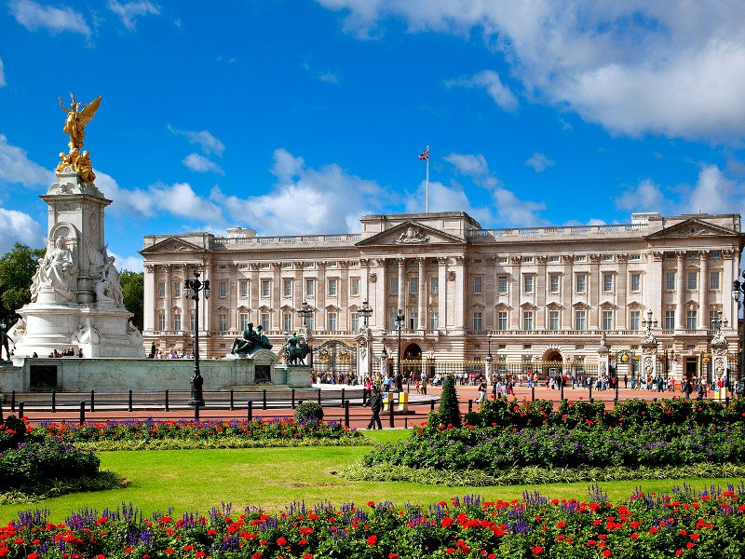
1
Buckingham Palace

Slide 7
C
A period of time
when you are a child.

Slide 8
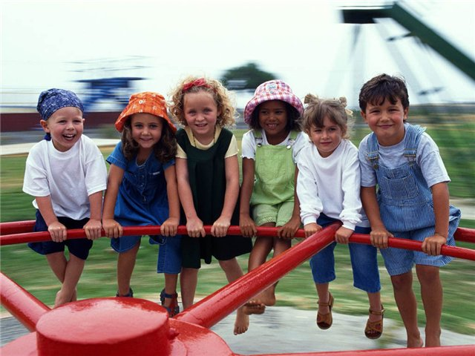
1
Childhood

Slide 9
D
A prehistoric animal
that disappeared million years ago.

Slide 10
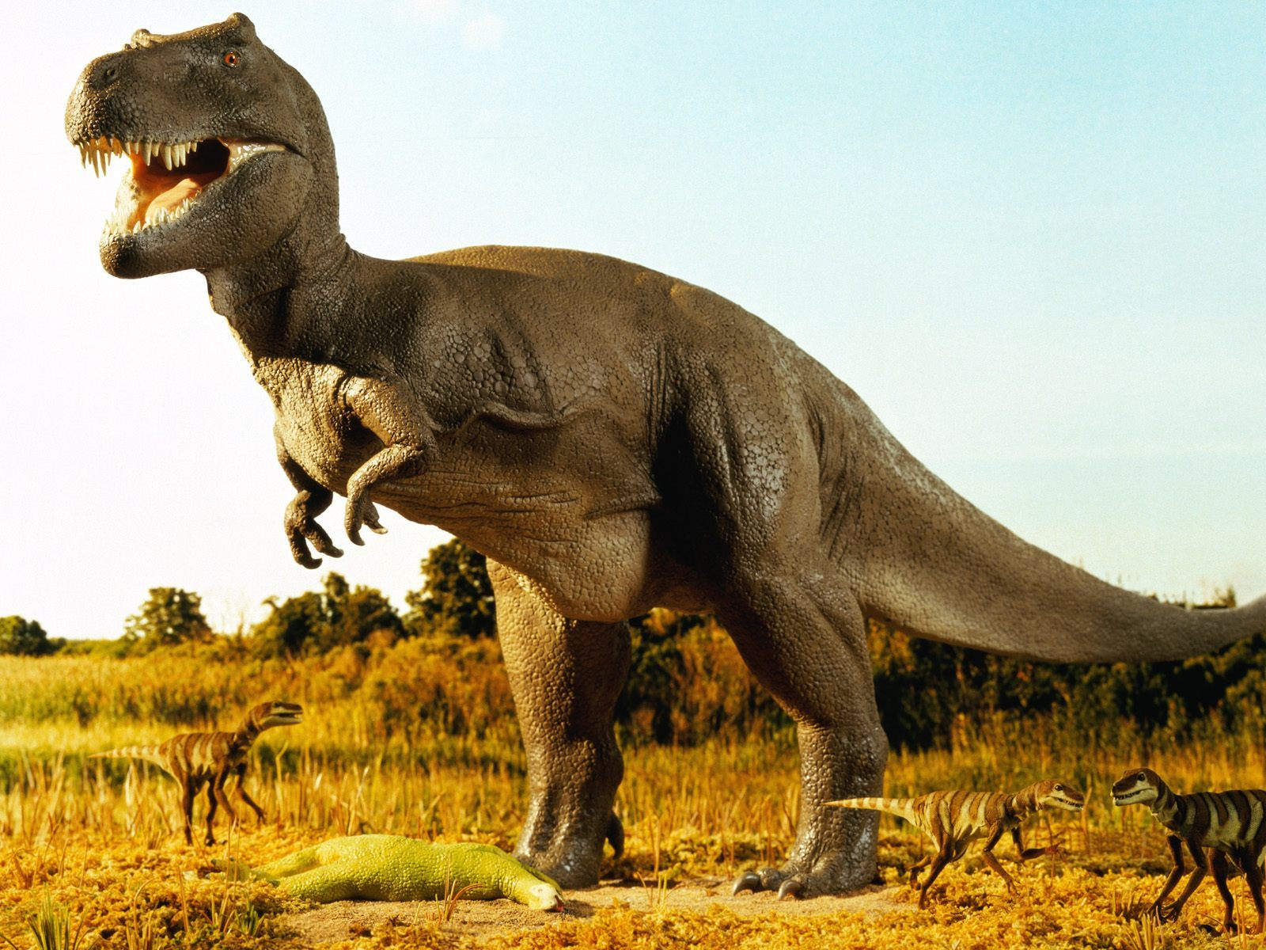
1
Dinosaur

Slide 11
E
It can be boiled or fried.

Slide 12
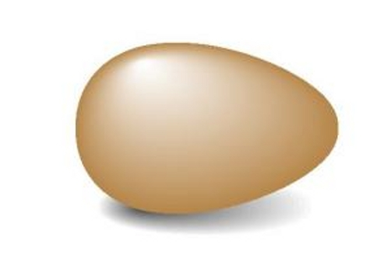
1
Egg

Slide 13
F
A group of people (parents and their children)
living together in one household.

Slide 14
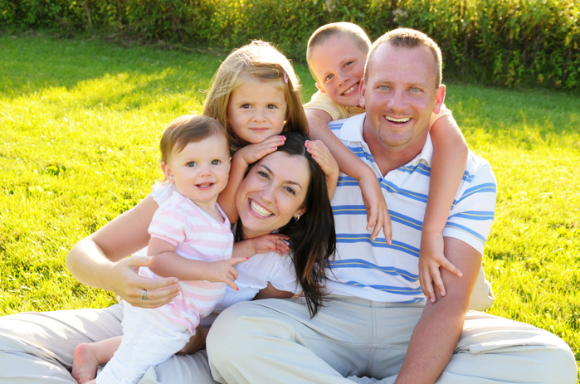
2
Family

Slide 15
G
An international environmental group
protecting wildlife.

Slide 16
2
Greenpeace

Slide 17
H
A sweet sticky substance
produced by bees,
used as food.

Slide 18
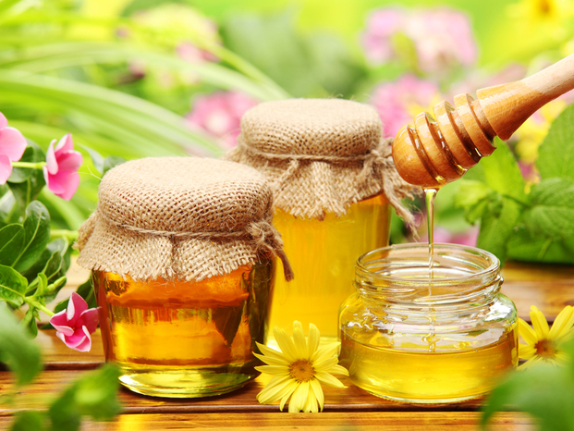
2
Honey

Slide 19
I
It is a network
of millions of computers all over the world
that are connected with each other
and work together.

Slide 20
2
Internet

Slide 21
J
It’s the synonym to
the word ”work”.

Slide 22
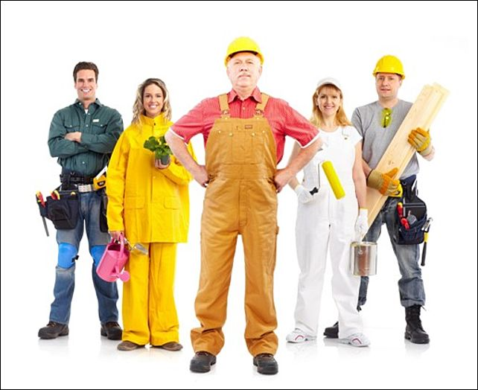
2
Job

Slide 23
K
A room for preparing
and cooking food.

Slide 24
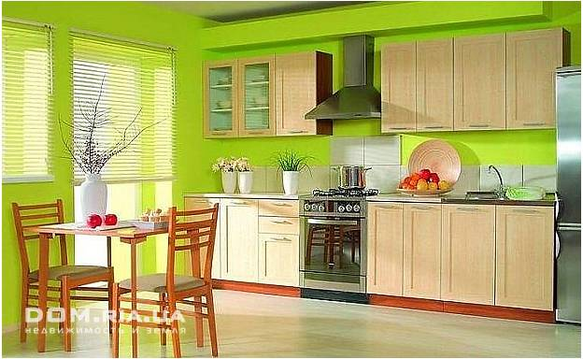
3
Kitchen

Slide 25
L
The capital of the United Kingdom
of Great Britain
and Northern Ireland.

Slide 26
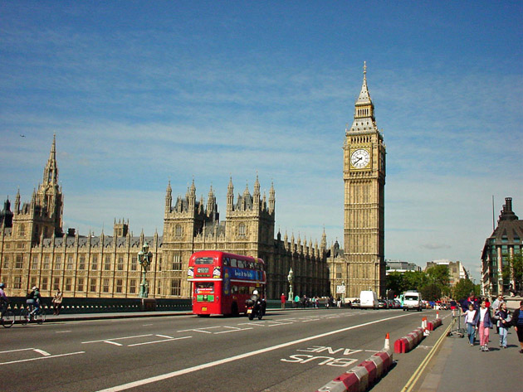
3
London

Slide 27
M
What you earn by working
and can use to buy things.

Slide 28
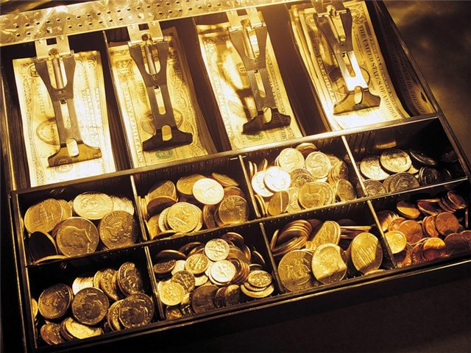
3
Money

Slide 29
N
A game which is similar to basketball,
played in Britain, especially by girls.

Slide 30
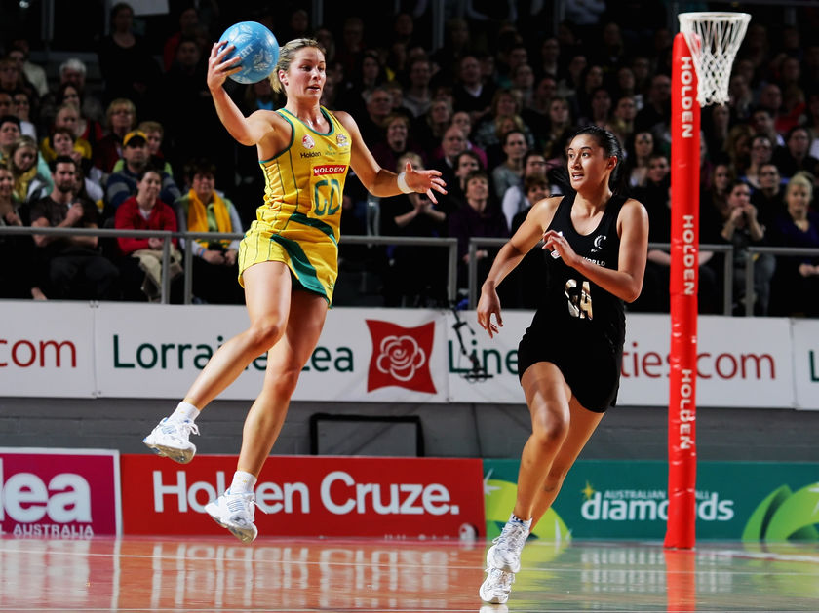
3
Netball

Slide 31
O
It’s a strong animal.

Slide 32
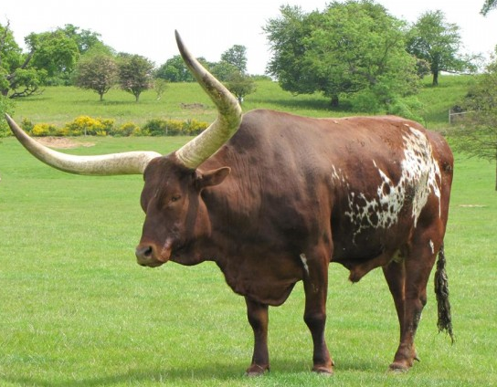
3
Ox

Slide 33
P
An animal that lives with people
at their homes.

Slide 34
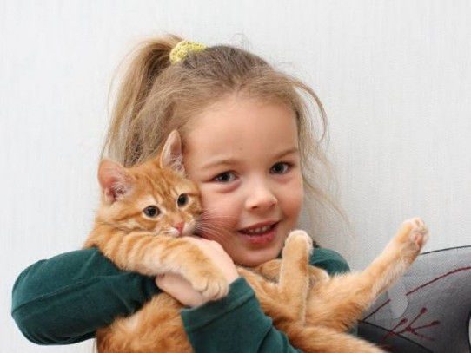
4
Pet

Slide 35
Q
The profession of
Elizabeth II.

Slide 36
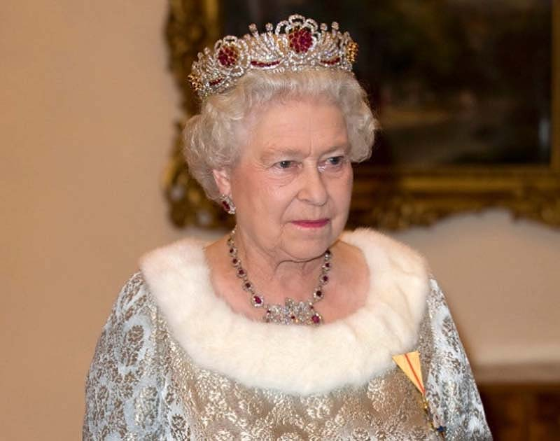
4
Queen

Slide 37
R
Someone who runs for sport
or pleasure.

Slide 38
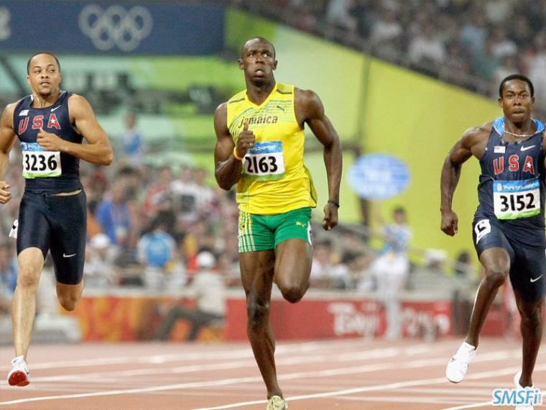
4
Runner

Slide 39
S
A very popular sport game
which is known as football.

Slide 40
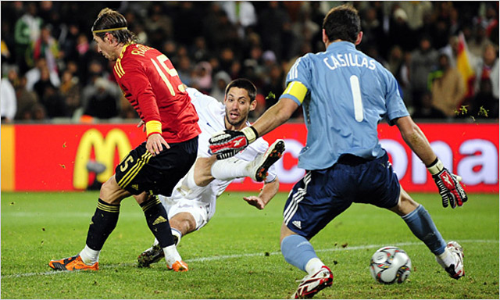
4
Soccer

Slide 41
T
It’s a kind of transport.

Slide 42
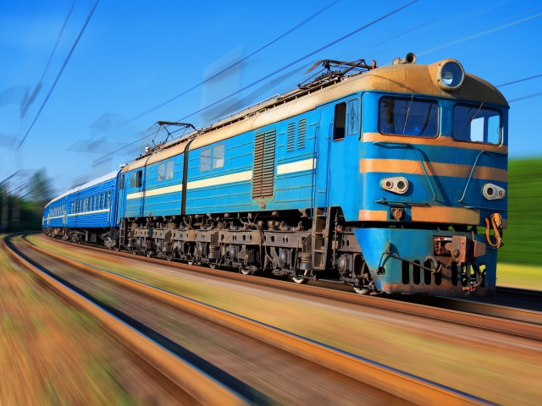
4
Train

Slide 43
U
The London railway system.
Also called the Metro or Tube.

Slide 44
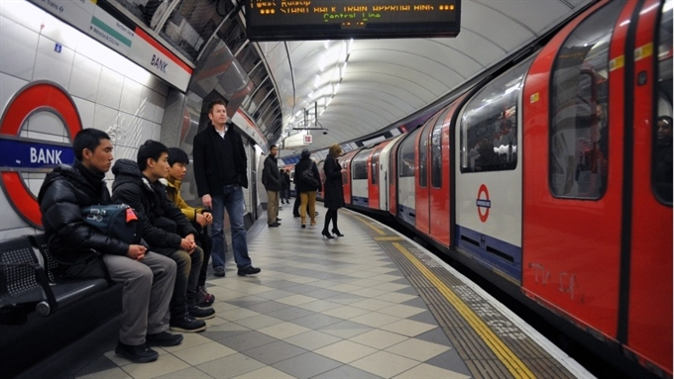
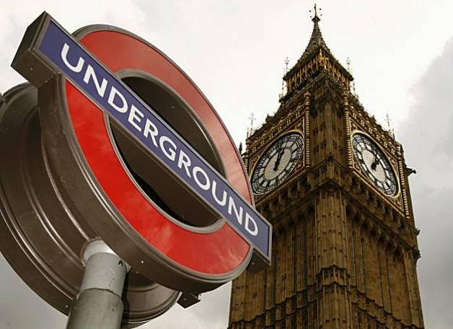
5
Underground

Slide 45
V
This queen had
the longest reign.

Slide 46
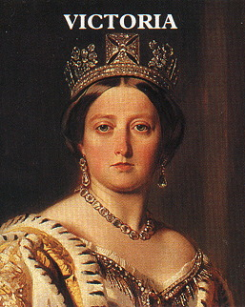
5
Victoria

Slide 47
W
A place where water
from a river or stream falls down
over a cliff or rock.

Slide 48
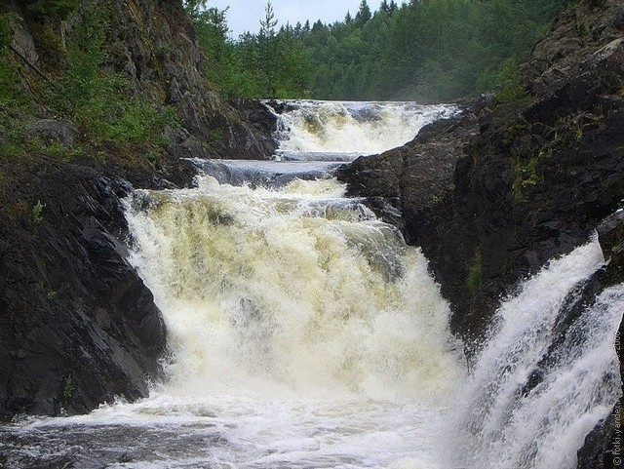
5
Waterfall

Slide 49
X
It’s a musical instrument.

Slide 50
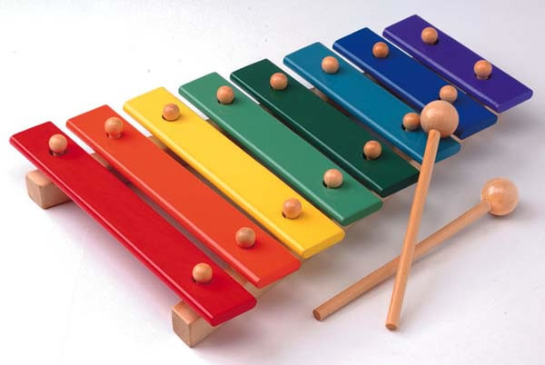
5
Xylophone

Slide 51
Y
Young people.

Slide 52
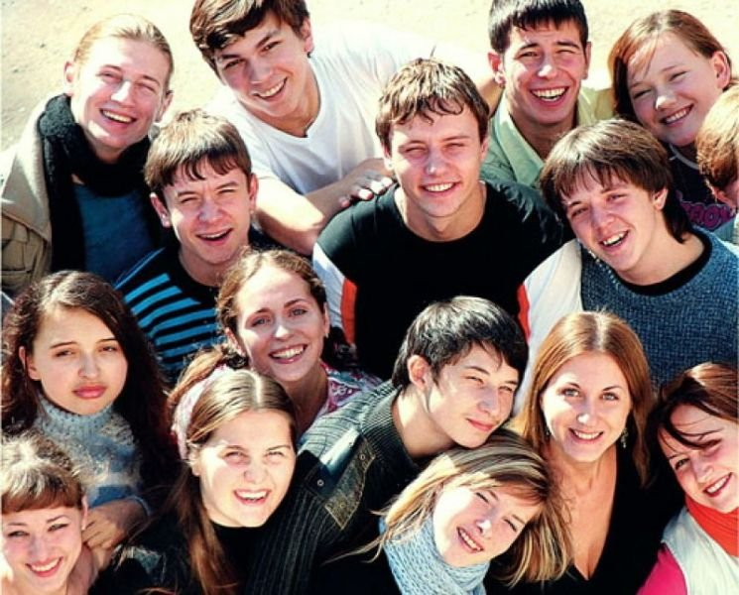
5
Youth

Slide 53
Z
It’s a number.

Slide 54
5
Zero

Slide 55
B
C
D
E
F
A
G
X
Y
Z
W
H
Thank you
for your
excellent work!!!
V
I
J
U
K
T
S
L
R
Q
P
O
N
M

