Slide 1
BODY

Slide 2
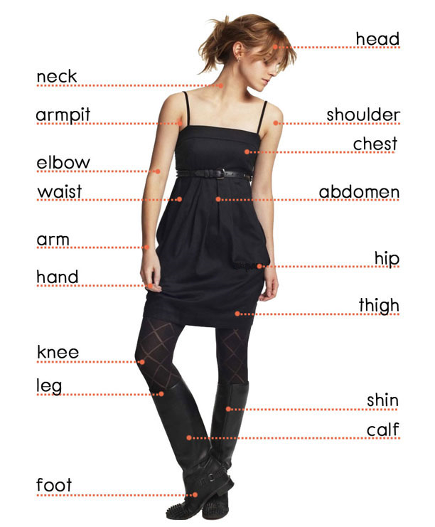
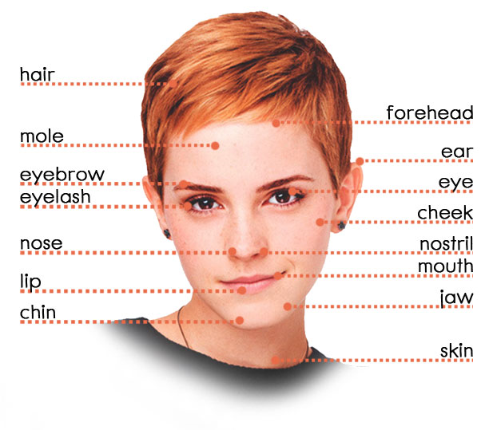

Slide 4
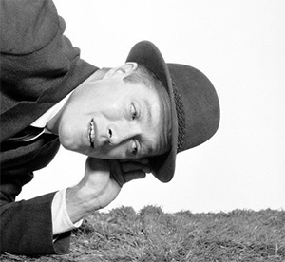
KEEP YOUR EAR TO THE GROUND
If you keep your ear to the ground, you make sure that you are aware of all that is happening and being said.
Aware – знать , быть в курсе.

Slide 5
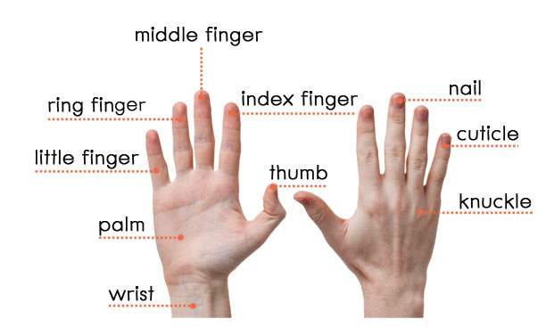
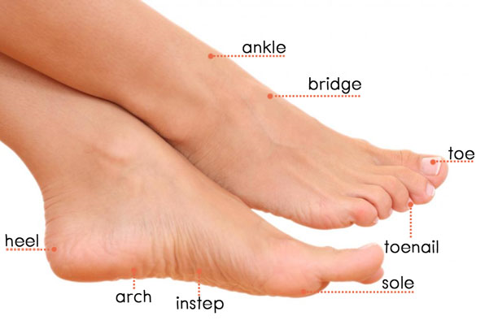
How many fingers does an ordinary Englishman have?

Slide 6
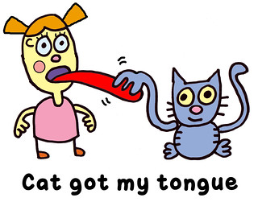
What does this idiom mean?

Slide 8
