Slide 1
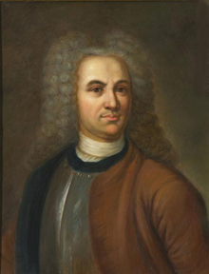
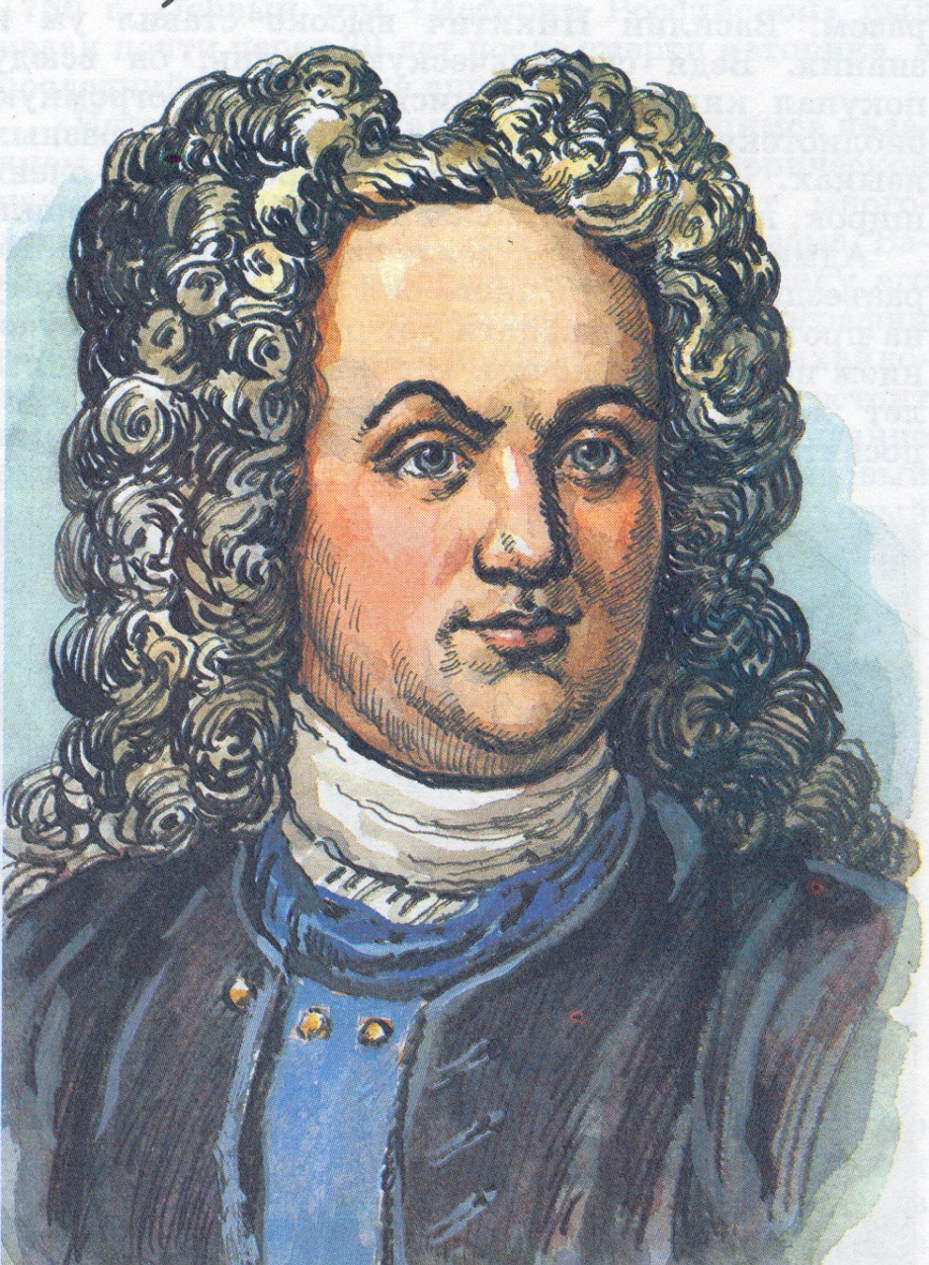
Tatishchev Vasily Nikitich

Slide 2
Purpose: To study the works and achievements of VN. Tatishcheva
Objectives: We study works and achievements VN. Tatischeva
Urgency: Tatishchev made a huge contribution to the development of the Urals, because during his lifetime he built 36 plants, and after his death 45 plants were built according to his plans!

Slide 3
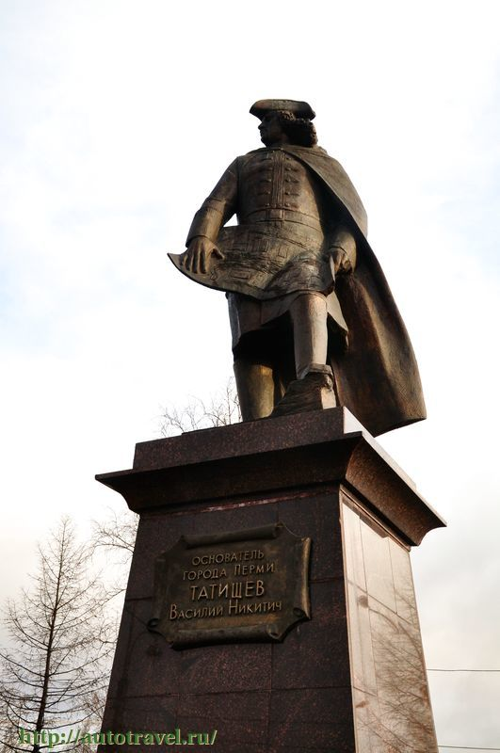
Tatishchev Vasily Nikitich is an outstanding scientist, mining worker, one of the brightest and most versatile "chicks of Petrov's nest".

Slide 4
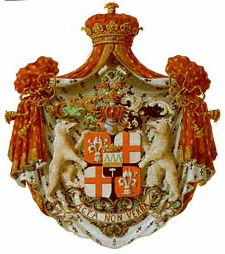
Tatishcheva V.N. was born on April 19, 1686 in Pskov. He came from a noble but poorly aristocratic family. He received education in the Moscow Artillery and Engineering School, which was headed by a prominent figure of the Petrine times, Jacob Bruce.

Slide 5
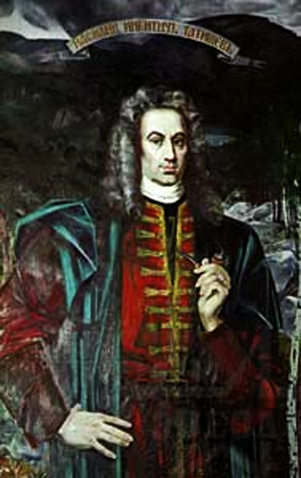
At the age of 18, he entered the military service. He took part in the siege and capture of Narva, the famous Poltava battle in the Prut march. I was repeatedly sent abroad with diplomatic rhetoric missions.

Slide 6
In 1719 Tatishchev received the assignment to compose the geography of Russia, a manual for the schools created by Peter at that time. His zeal in geography was, however, soon interrupted by his appointment in March 1720 to the Urals as the head of the Ural plants.

Slide 7
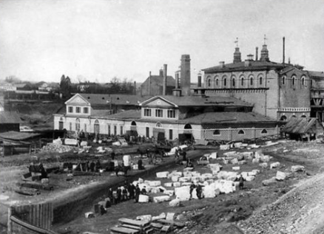
In the Urals, Tatishchev develops active activities in the construction of plants, establishes the center of the mining Ural - Yekaterinburg and the city of Perm.

Slide 8
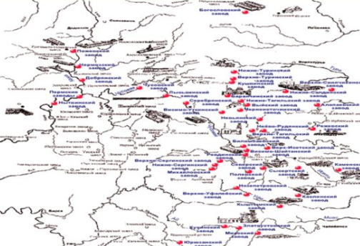
From 1720-1730 he managed the mining factories in the Urals, showing himself to be a resolute administrator, alien to servility, than he made a lot of enemies. The result of his activity is 36 metallurgical plants, 45 were built according to his plan of the family, half a death.

Slide 9
In the same place, he continued to study the geography of Russia. He was the first to think of an attempt to collect geographical information by means of a special questionnaire sent to the field on behalf of the Academy of Sciences. Tatishchev's anatomy differs in its heterogeneity and strictly scientific character, and is of considerable interest for the method of field geographic surveys.

Slide 10
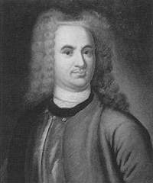
Already one merit puts him in the first ranks of the pioneers of Russian geography. Tatishchev quite clearly understood the complex nature of geography, the necessity of studying nature and economy in their mutual connection.

Slide 11
In the field of cartography Tatishchev did a lot when he was in charge of geodesic work in Russia for some time. He paid special attention to the quality of the survey, he prepared an instruction for surveyors.

Slide 12
Tatishchev was the first theoretician of geography in Russia. His remarkable activity in the areas of geography Tatishchev had an enormous influence on the development of this science in Russia.

Slide 13
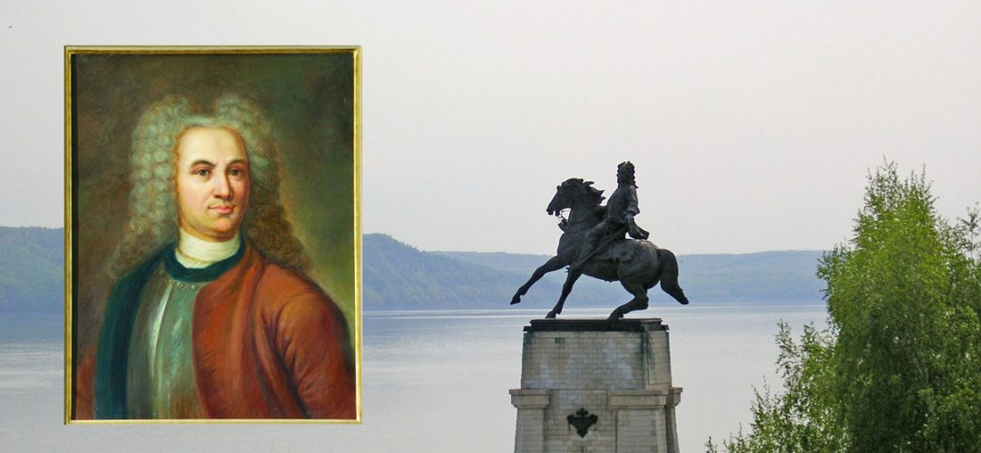
He was not alone. From his census it is known that his works aroused interest in the largest Gygoraph P.I.Rychkov. He also had a great influence on M.Lomonosov, who was to him with great respect, as can be seen from their notes.

Slide 14
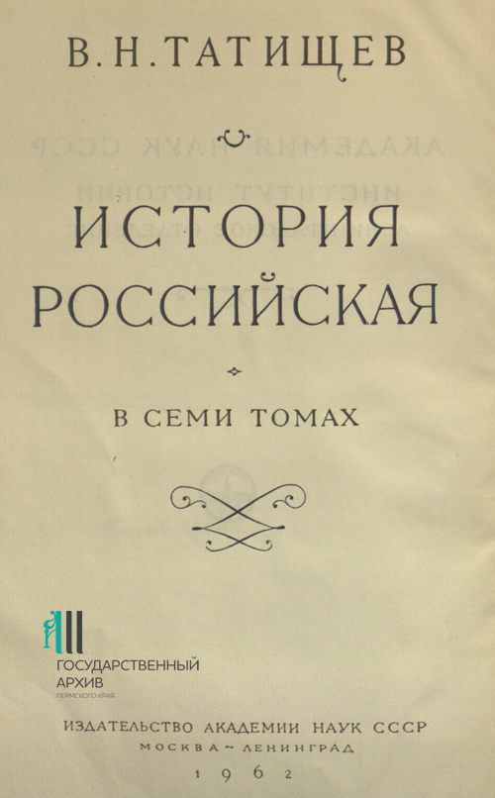
Nobody before him has created with such distinct clarity the practical importance of geography for people's self-consciousness, for state administration, for economic construction, and no one before Tatishchev struggled with such passion, devotion and energy for the cause of widespread development of the development of geagarafic education in our country.

Slide 15
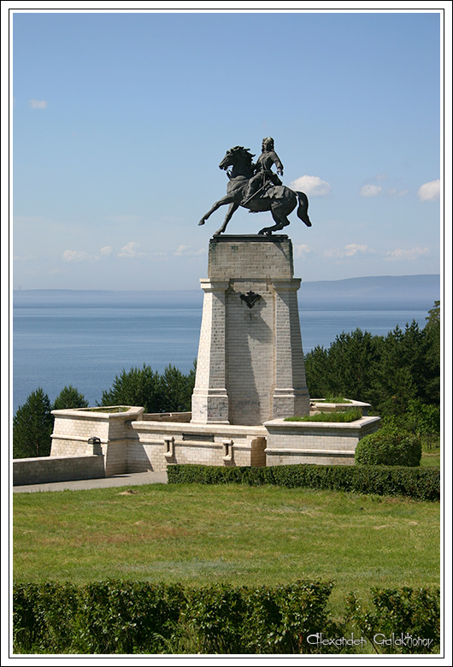
Tatishchev, a pupil of the Petrine era, had the ability to place science at the service of practical goals. In particular, he associated geography with the tasks of Russia's economic development, as well as with its military and administrative needs.

Slide 16
Unfortunately, since 1737 Tatishchev began persecution. Some statesmen wanted to oust Tatishchev from the mining. In relation to him, several provocations were committed. In 1740 he was arrested, imprisoned in the Peter and Paul Fortress and deprived of all ranks.

Slide 17
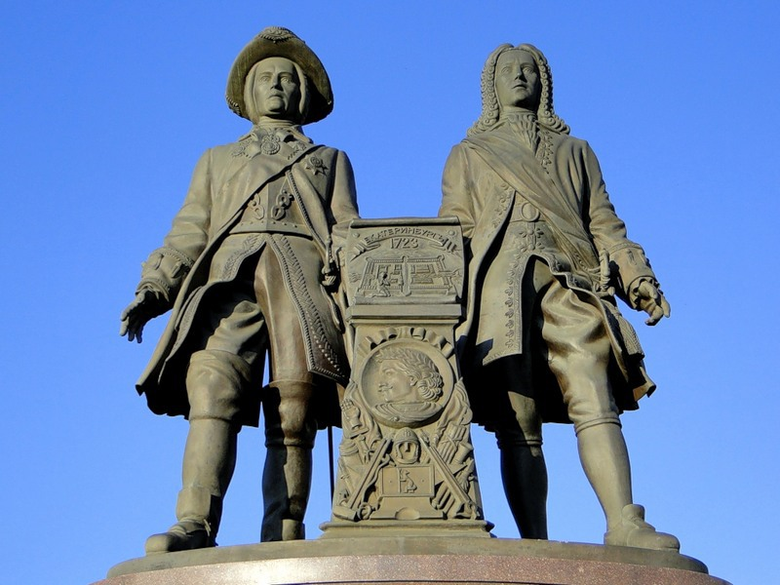
In 1745, the village of Boldino was exiled to his ancestral estate. He died in 1750. U. Tatischeva. left two children, thanks to his daughter, he became the great-grandfather of the poet Tyutchev.

