Slide 1
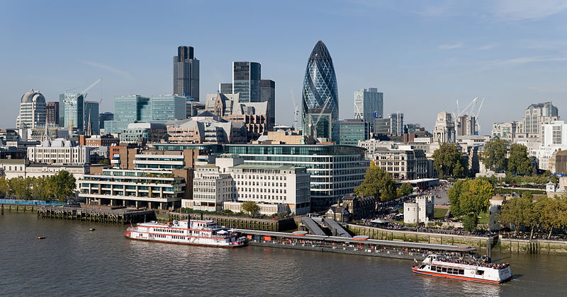
LONDON

Slide 2
London was founded about 2000 years ago by the Romans.
It was called Londinium

Slide 3
A surviving fragment of the London Wall, built around 200 AD.

Slide 4
It’s one of the biggest cities in Europe
There are more than 10 million people
living in the city,
And it’s about
600 sq miles.

Slide 5
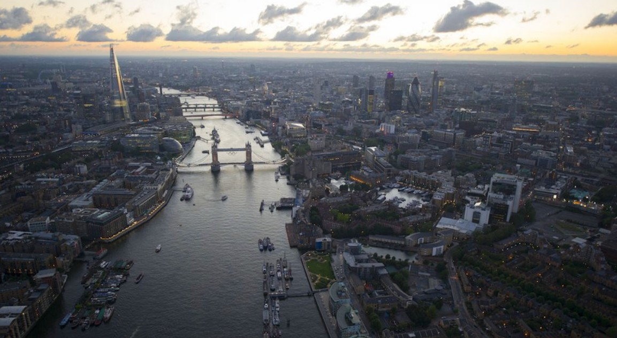
It is crossed by the River THAMES

Slide 6
There are many important and famous monuments.

Slide 7
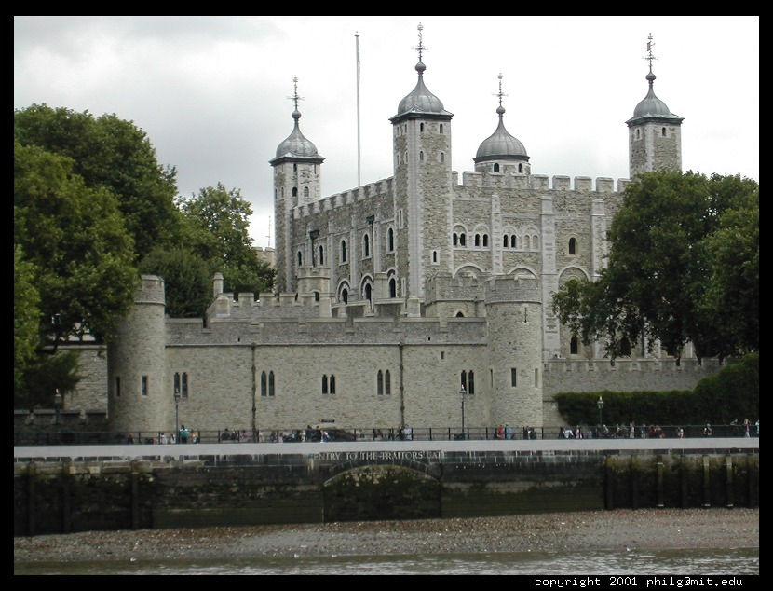
The Tower of London

Slide 8
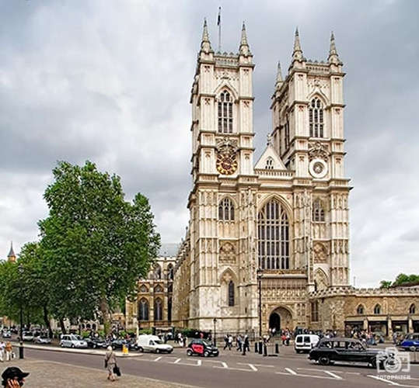
Westminster Abbey

Slide 9
St Paul’s Cathedral

Slide 10
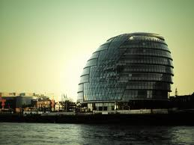
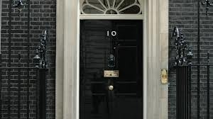
The City Hall
10, Downing Street

Slide 11
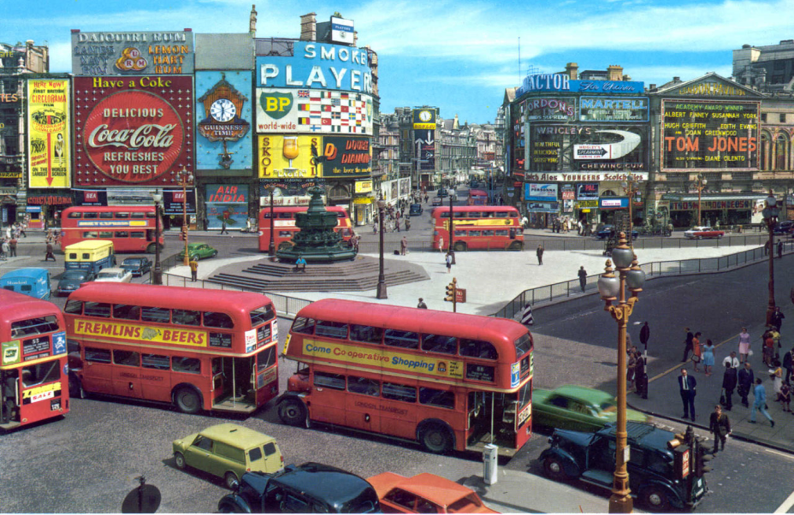
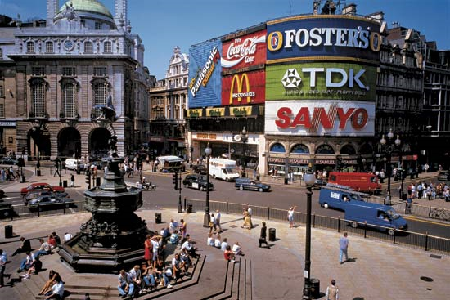
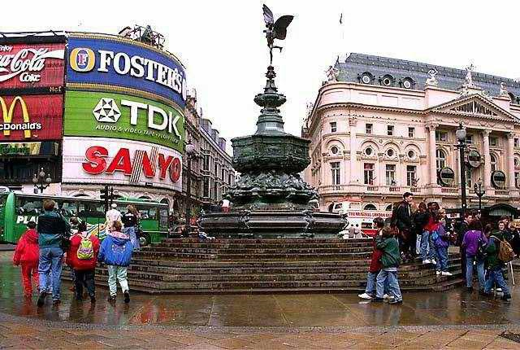
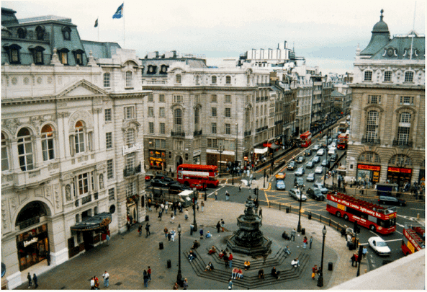
Piccadilly Circus

Slide 12
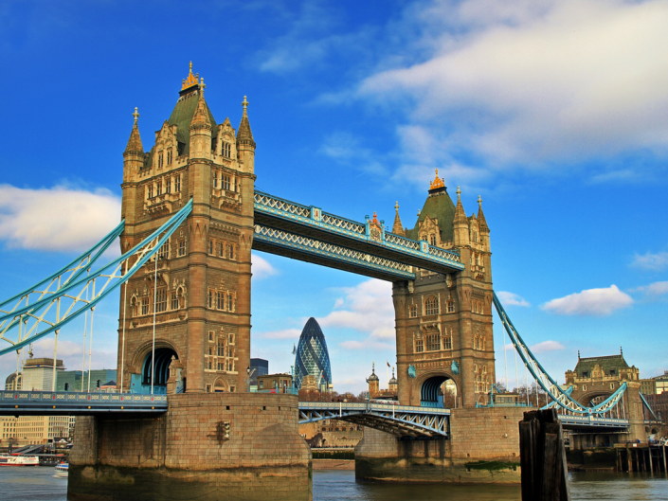
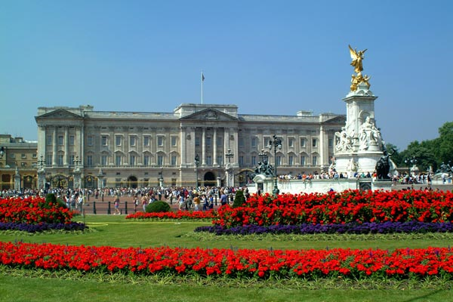
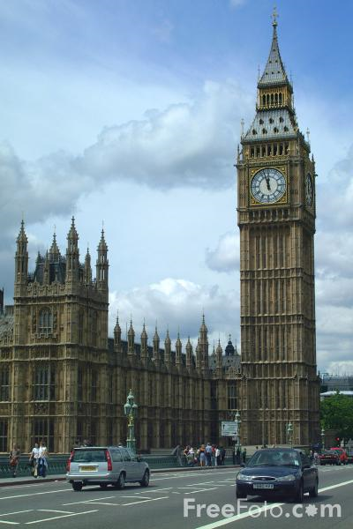
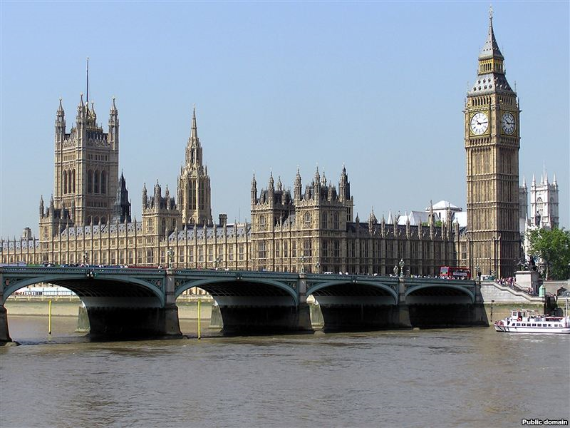

Slide 13
London Tube

Slide 14
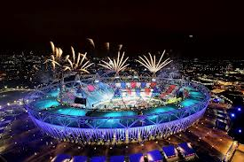
In 2012, the Summer Olympic Games were organized in London

